Slide 1
Interaction
Word vectors are created from a children’s novel – it has two sentence as mentioned below
Please stick to the rules.
Children have collected sticks for a bonfire.
Will Word vector learn two different vector representations of stick? How?
2. Can LSTMs encode context?
3. How does LSTM preserve long term dependencies?
4. What is the advantage of using BiLSTm over LSTM – what kind of applications can benefit – and why?
5. What is the advantage of attention layer? Why is it needed?

Slide 2
Transformer based Language Models
BERT (BIDIRECTIONAL ENCODER REPRESENTATIONS FROM TRANSFORMERS)

Slide 3
DEEP CONTEXTUALIZED WORD REPRESENTATIONS
Words are ambiguous – multiple senses
Why should there be only one representation?
I will stick to the syllabus.
I will beat you with a stick.
The neighborhood of stick should be different in the two sentences

Slide 4
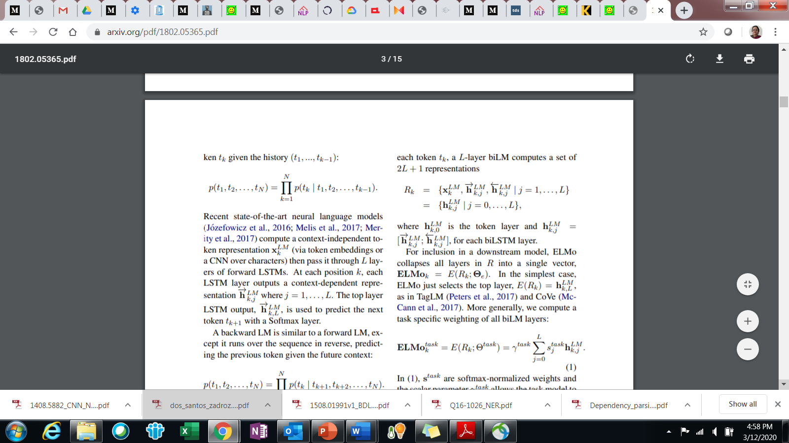
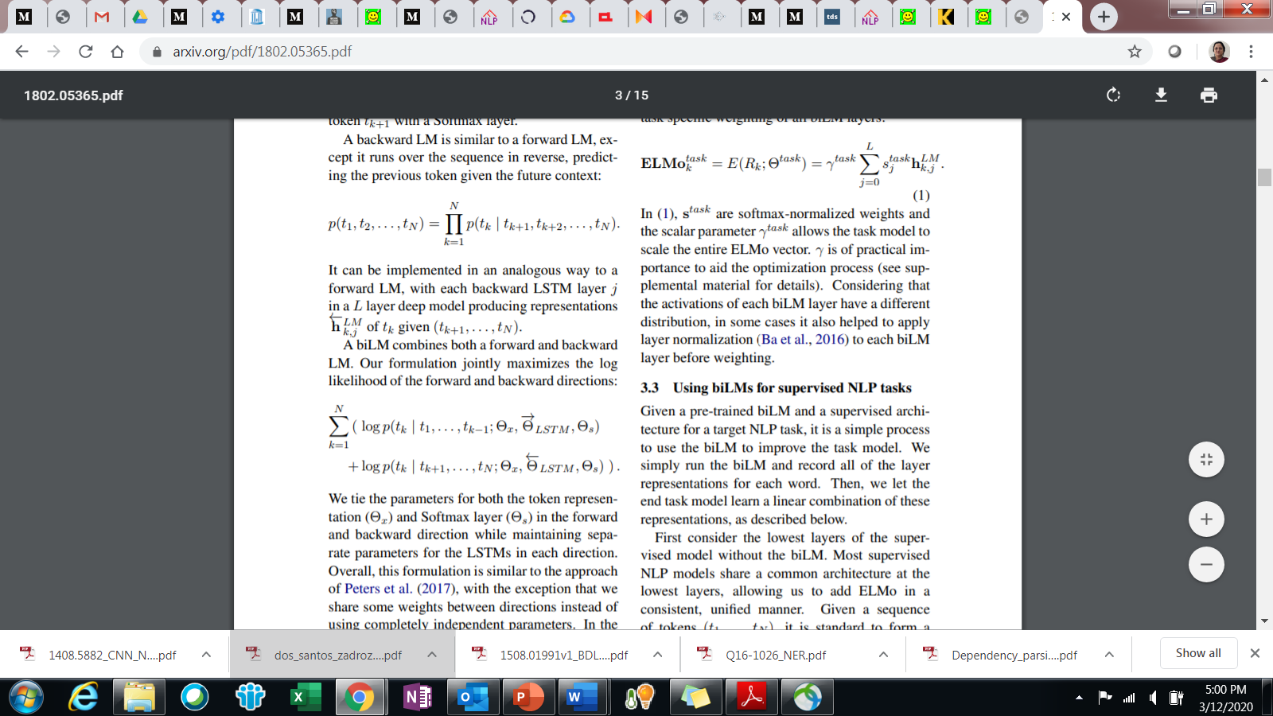
ELMO – EMBEDDED LANGUAGE MODEL
Word embeddings in which each token is assigned a representation that is a function of the entire input sentence
Given a sequence of N tokens, (t₁, t₂, ..., t_{N} ) - combine all past and future tokens to generate representation
Maximize Log Likelihood

Slide 5
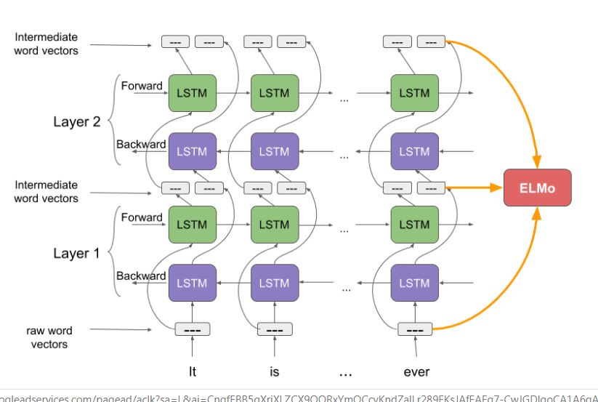
ELMO ARCHITECTURE

Slide 6
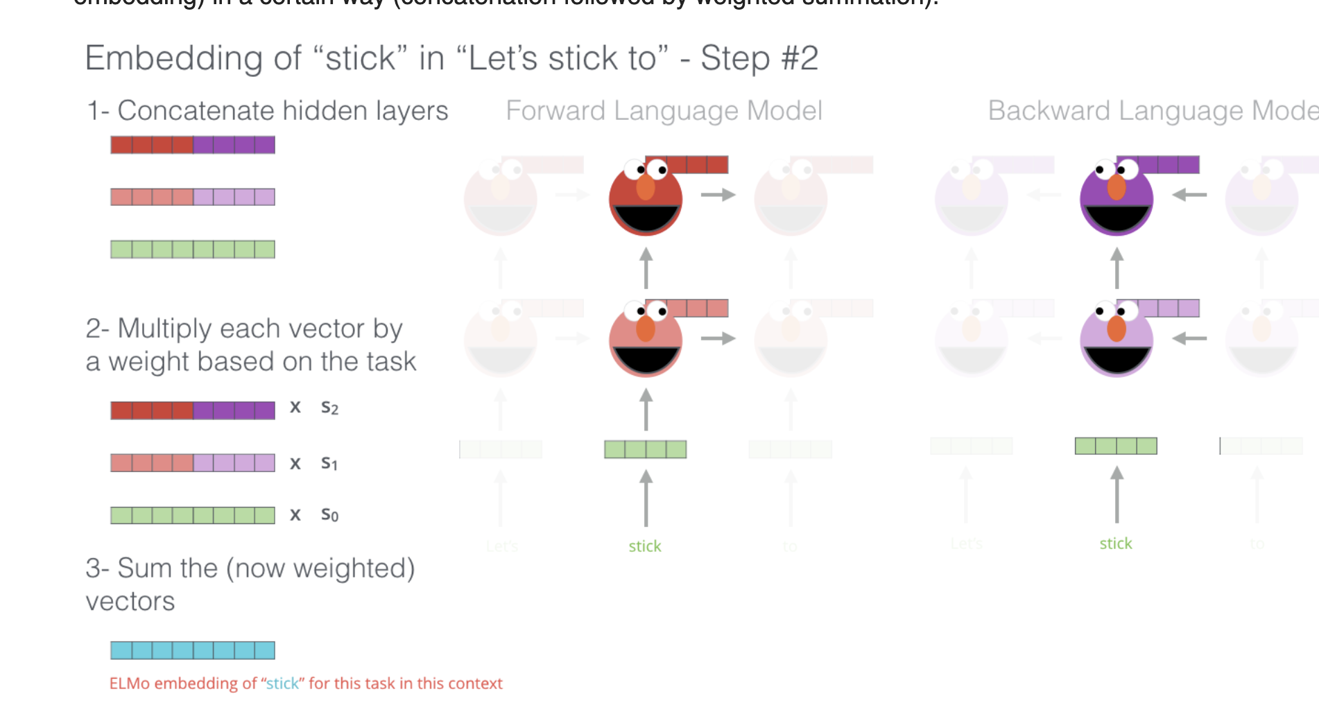

Slide 7
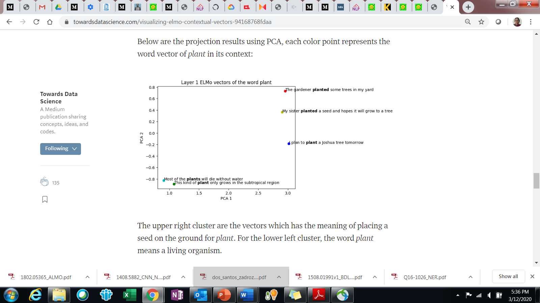
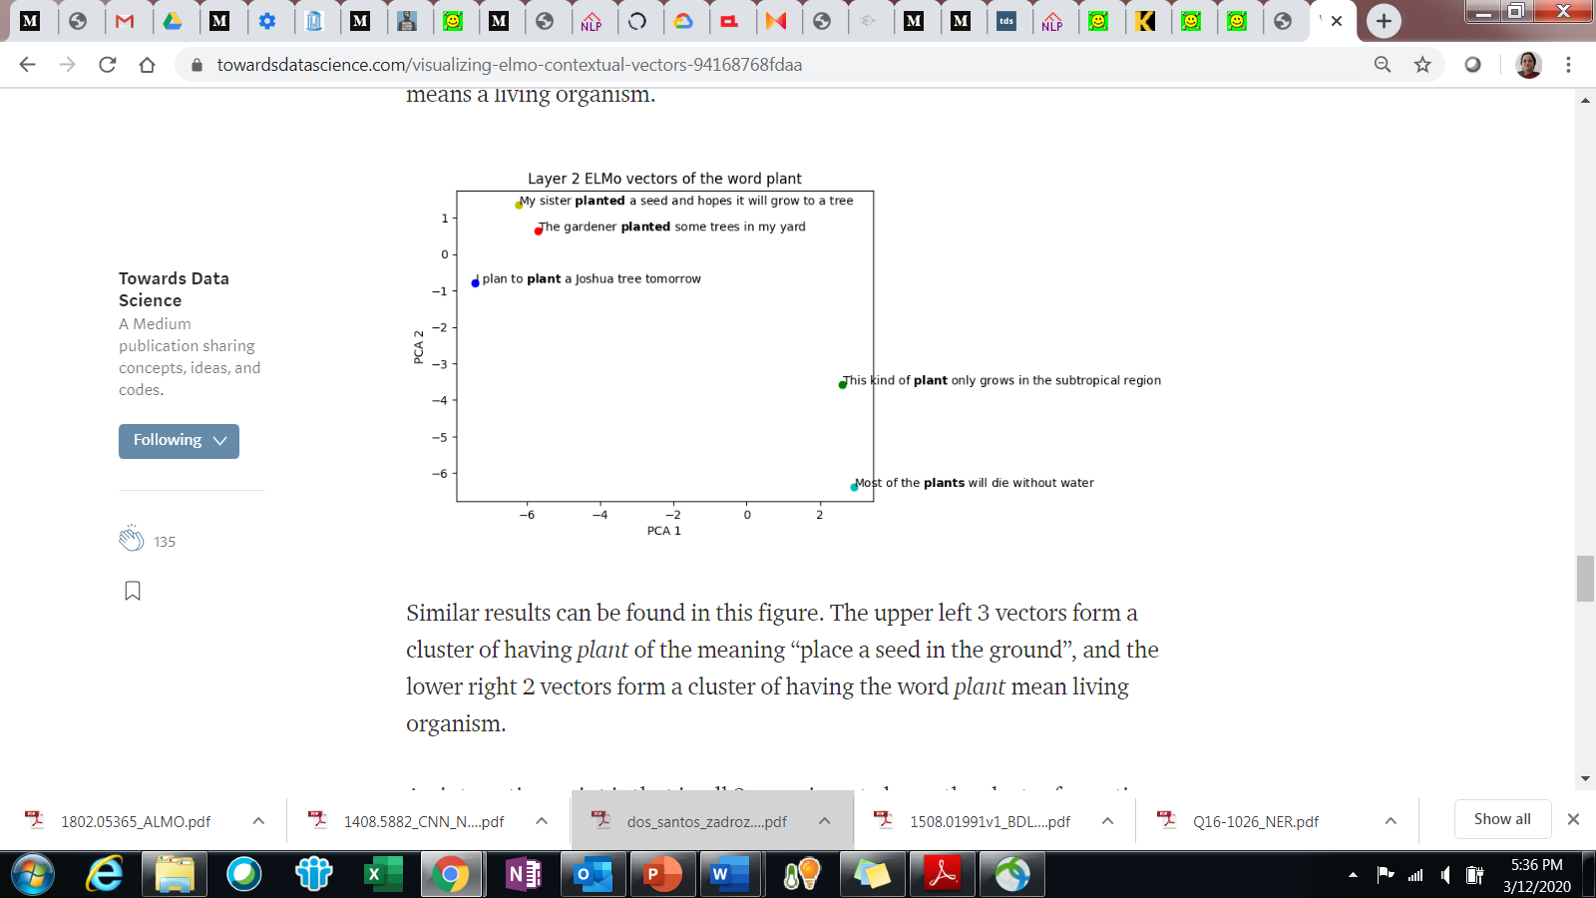
VISUALIZATION

Slide 8
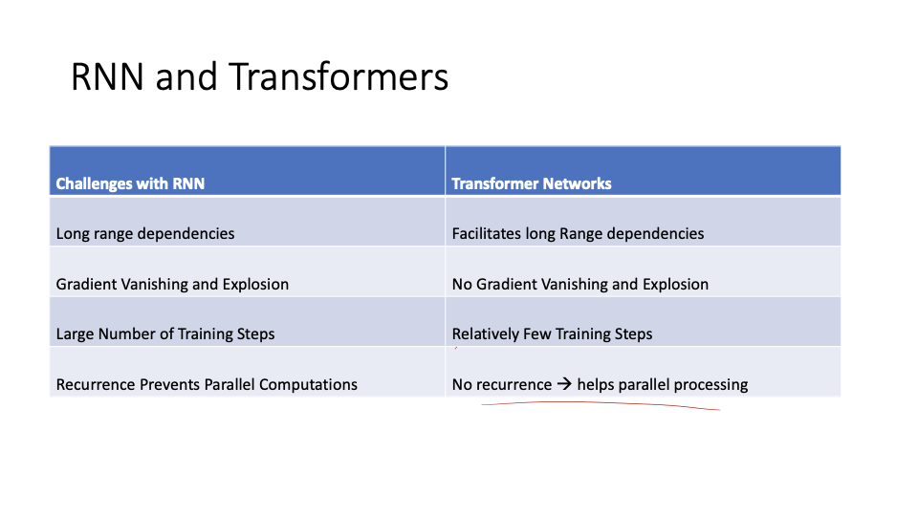
Some challenges that remained

Slide 9
Transformer Architecture
Transformer architecture was introduced as a novel pure attention-only sequence-to-sequence architecture
Ability for parallelizable training
General performance improvement

Slide 10
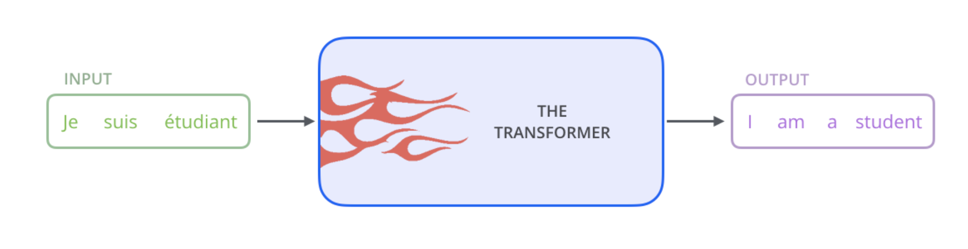
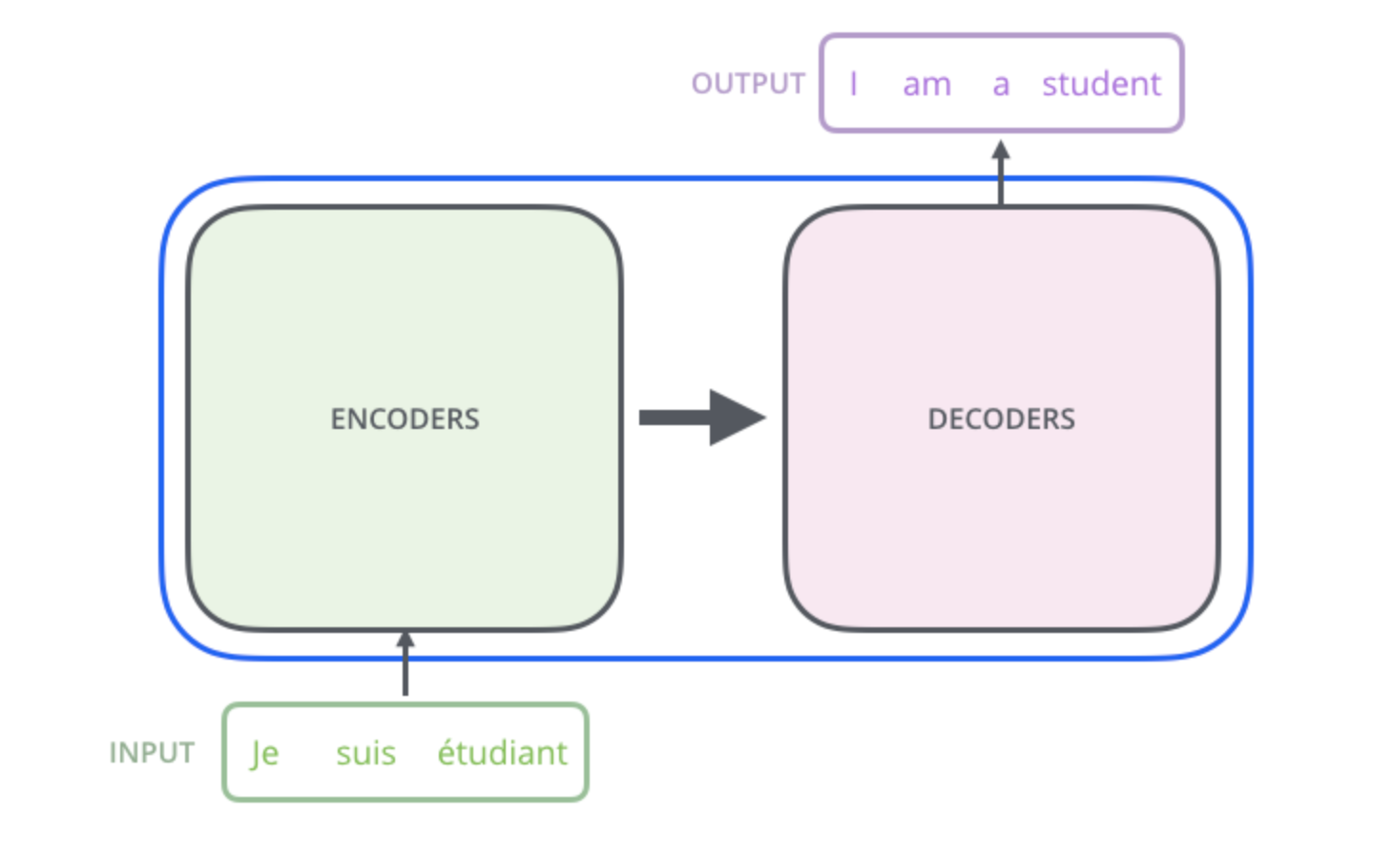
The Transformer network
Source - http://jalammar.github.io/illustrated-transformer/

Slide 11
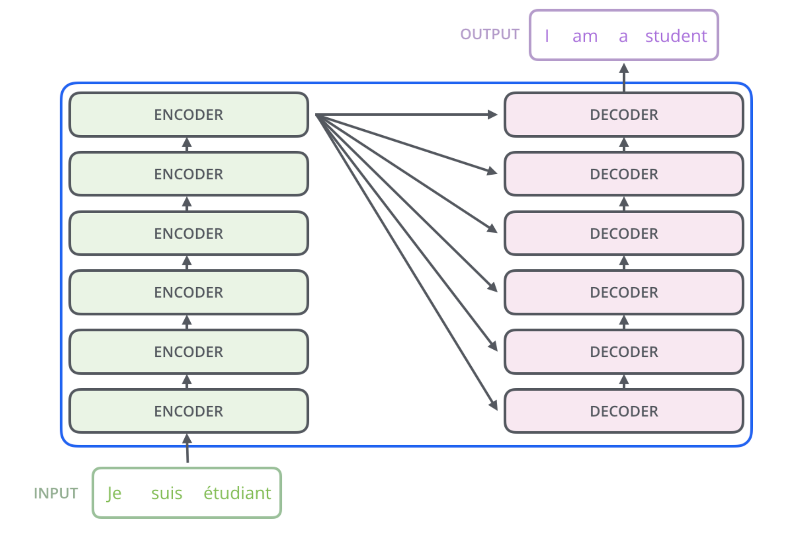
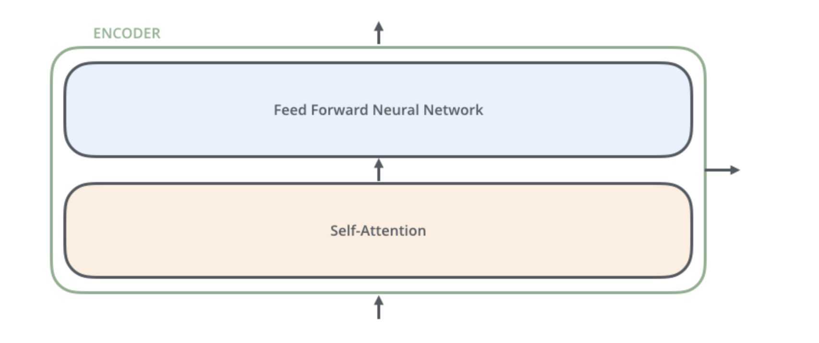
Peeping inside

Slide 12
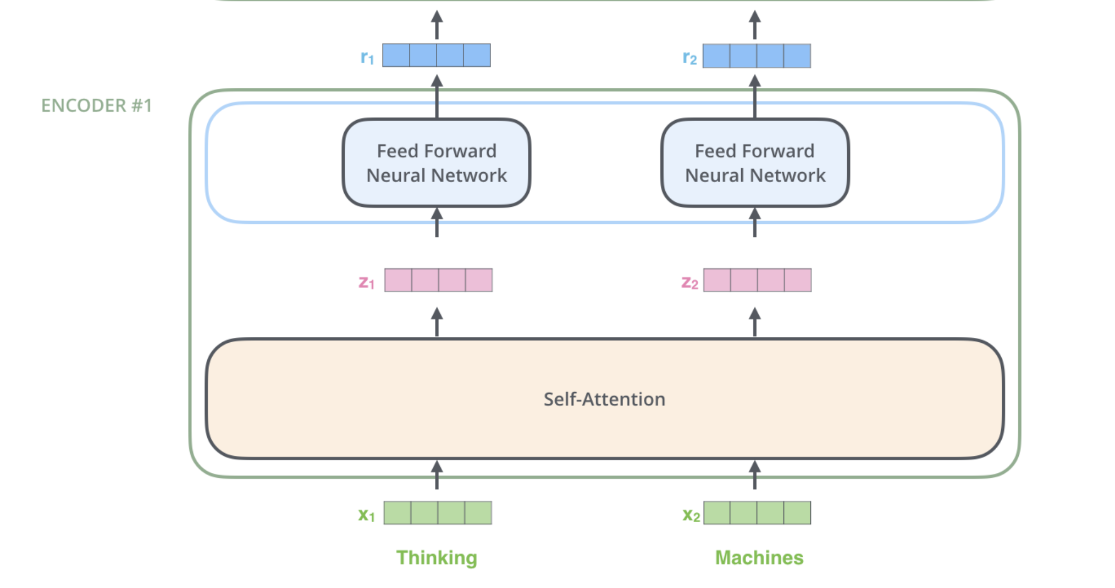
Word in each position flows through its own path in the encoder
Dependencies between these paths are learn in the self-attention layer.
Feed-forward layers do not have those dependencies

Slide 13
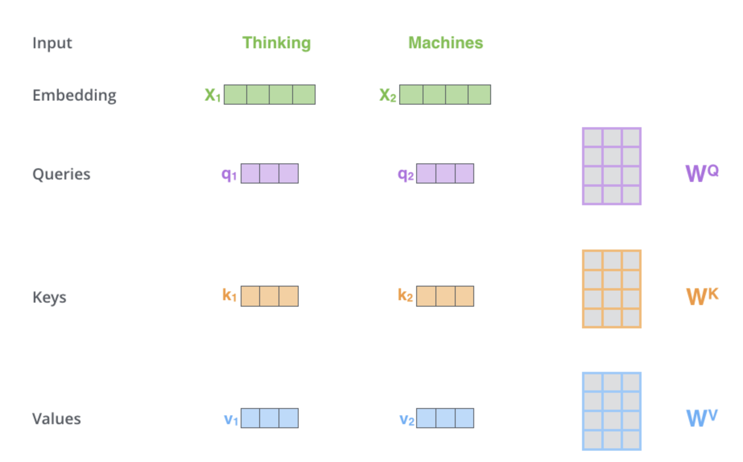
Self attentions
Create three vectors from each word embedding of size 512
For each word - create a Query vector, a Key vector, and a Value vector by multiplying the embedding by three matrices that are trained during the training process.
These new vectors are smaller in dimension than the embedding vector
Typical dimensionality is 64, while the embedding and encoder input/output vectors have dimensionality of 512

Slide 14
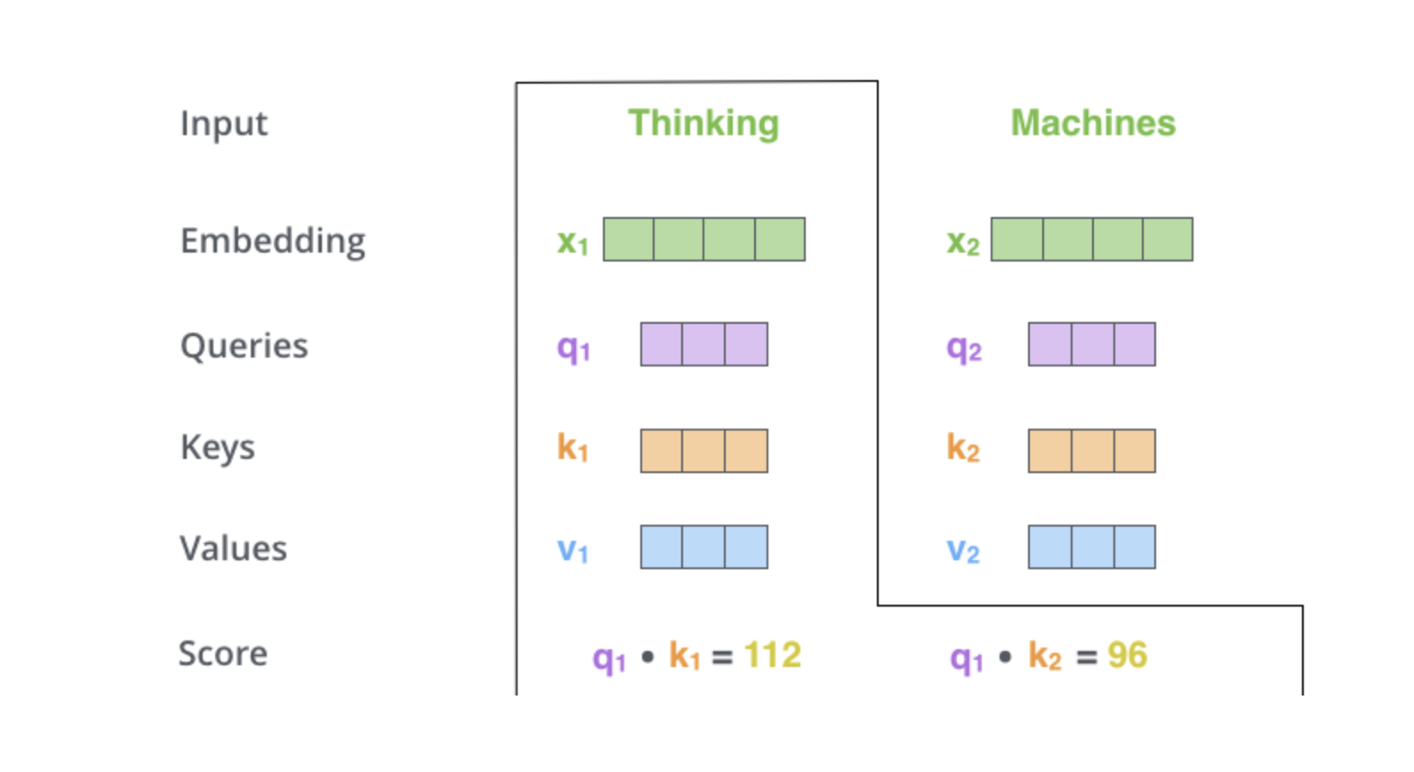
Query and Key are abstractions for calculating attention
Calculating the self-attention for the first word in this example, “Thinking” - will involve scoring each word of the input sentence against this word
The score determines how much focus to place on other parts of the input sentence as we encode a word at a certain position
The score is calculated by taking the dot product of the query vector with the key vector of the respective word we’re scoring
So if we’re processing the self-attention for the word in position #1, the first score would be the dot product of q1 and k1. The second score would be the dot product of q1 and k2.

Slide 15
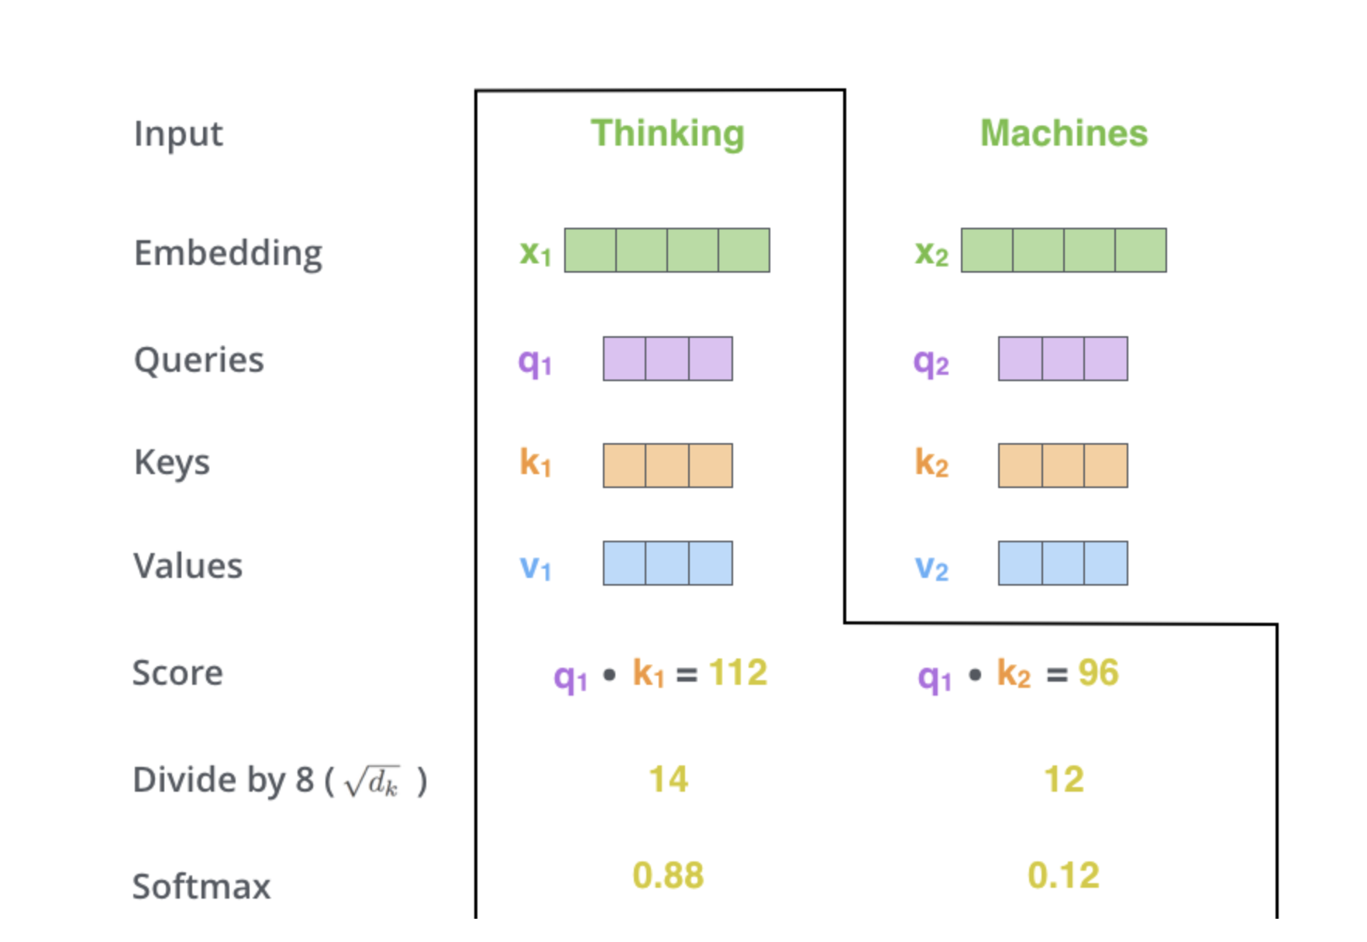
Divide the scores by 8 (the square root of the dimension of the key vectors) – 64.
This leads to having more stable gradients. T
Pass the result through a softmax operation - Softmax normalizes the scores so they’re all positive and add up to 1

Slide 16
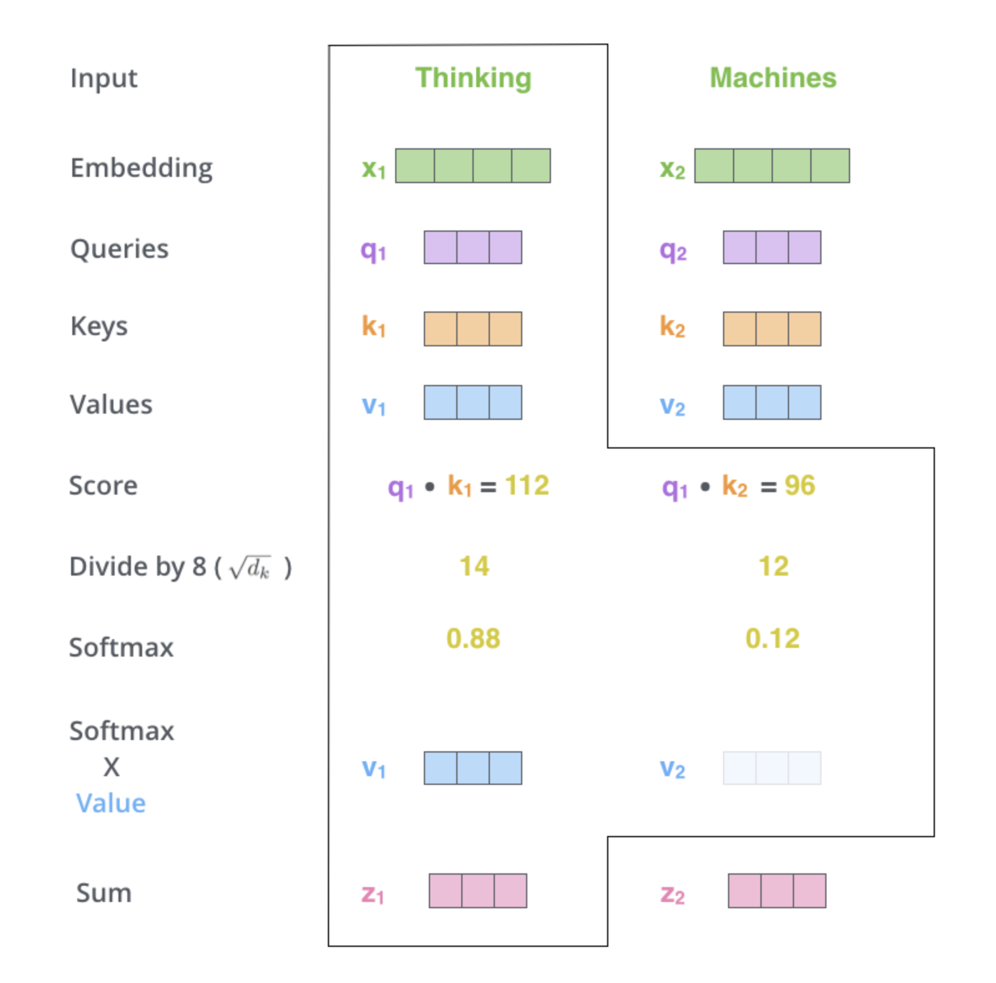
Softmax score - determines how much each word will be expressed at this position
Obviously highest for the word at this position - but another word that is relevant to the current word will also get attention
Multiply each value vector by the softmax score - The intuition here is to keep intact the values of the word(s) we want to focus on, and drown-out irrelevant words (by multiplying them by tiny numbers like 0.001, for example
Sum up the weighted value vectors
Produces the output of the self-attention layer at this position

Slide 17
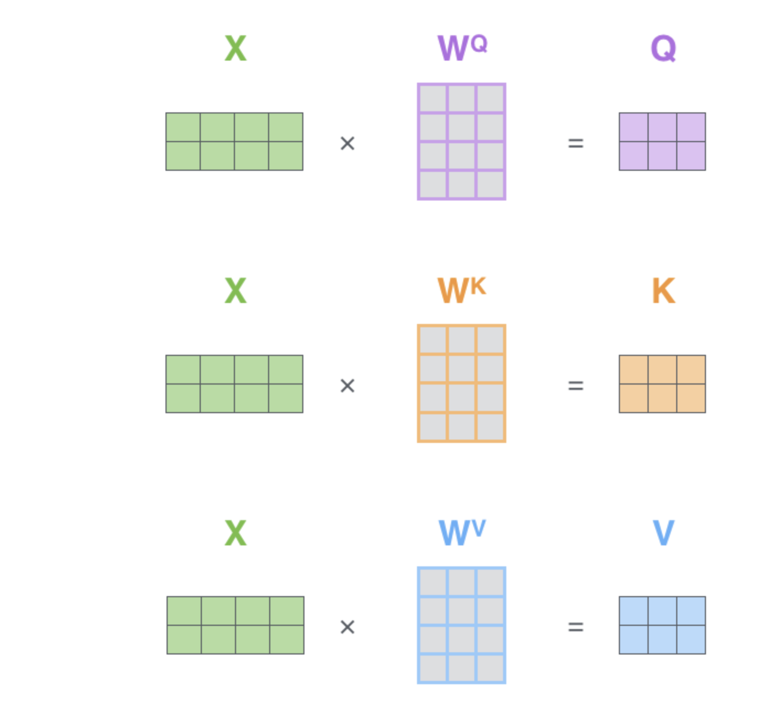
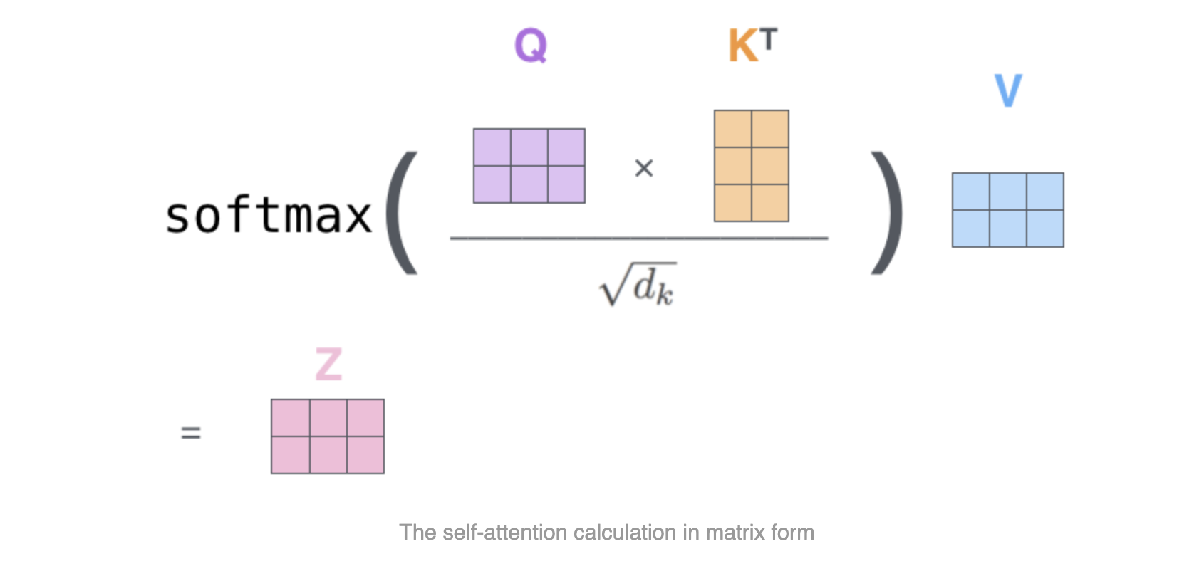
Calculation

Slide 18
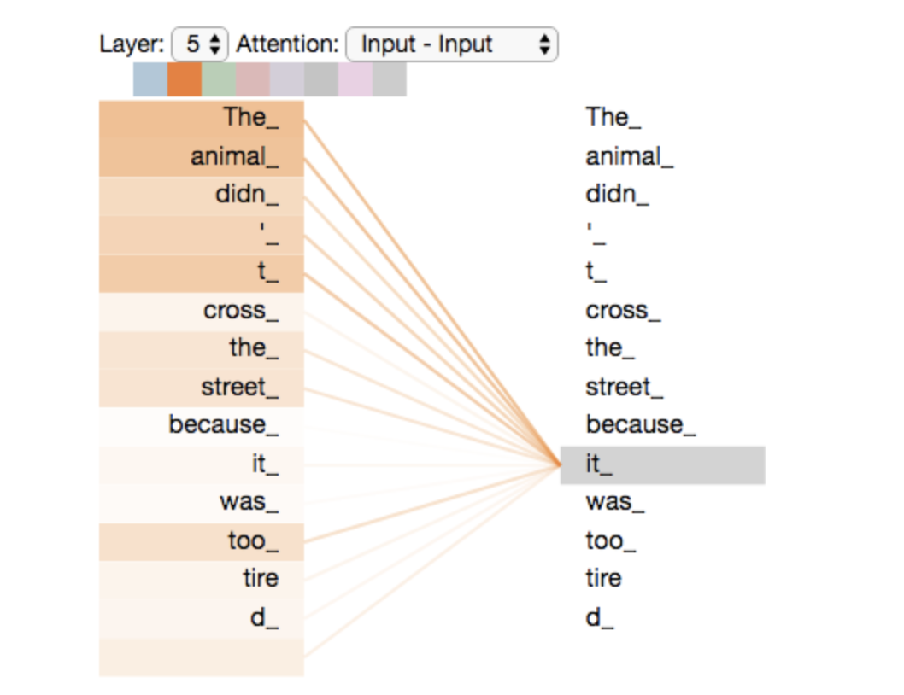
Self Attention
The animal didn't cross the street because it was too tired
Self attention allows each word (each position in an input sequence) look at other positions (words) in the input sequence for clues that can help lead to a better encoding for this word
When the model is processing the word “it”, self-attention allows it to associate “it” with “animal”

Slide 19
Multi-headed Attention utility
Expands the model’s ability to focus on different positions.
A single z1 could be dominated by the the actual word itself
While translating a sentence like “The animal didn’t cross the street because it was too tired”, - it would be useful to know which word “it” refers to
Using multi-headed attention layers multiple “representation subspaces” are created
With multi-headed attention - multiple sets of Query/Key/Value weight matrices are created - typically eight attention heads are used for each encoder/decoder
Each of these sets is randomly initialized
After training, each set is used to project the input embeddings (or vectors from lower encoders/decoders) into a different representation subspace.

Slide 20
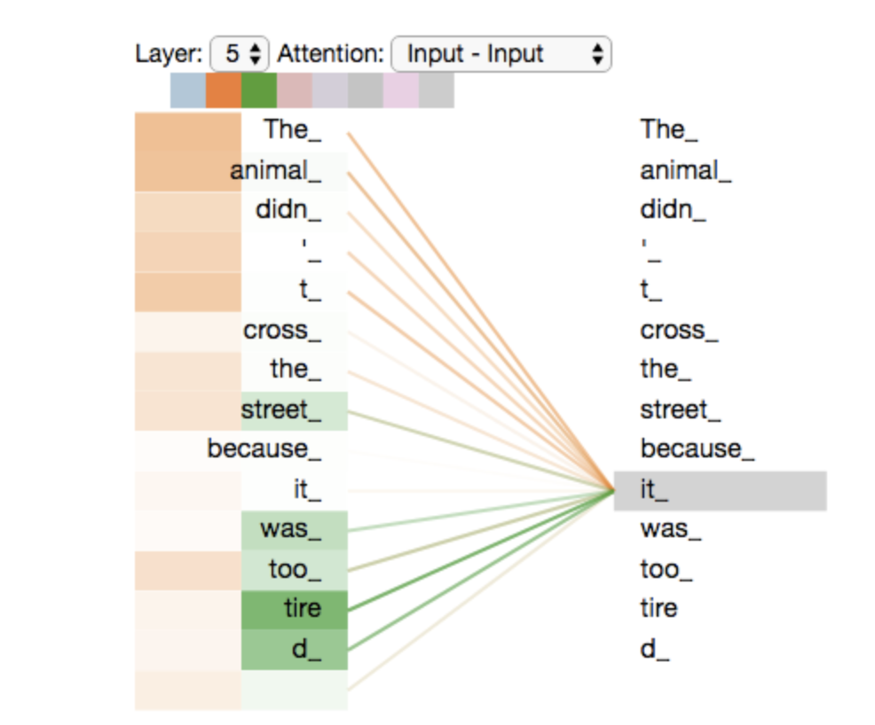
Example
Head 1
Head 2

Slide 21
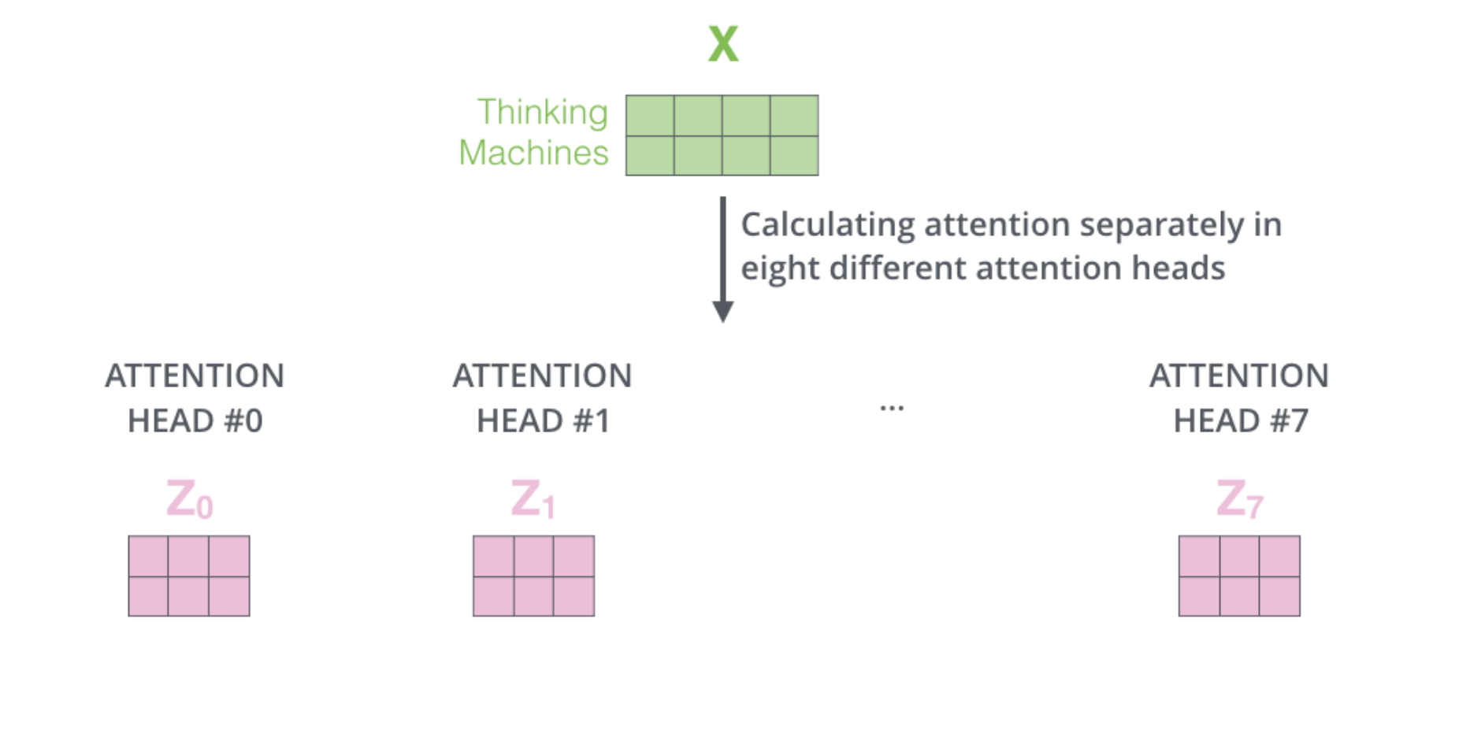
Multi-headed Attention

Slide 22
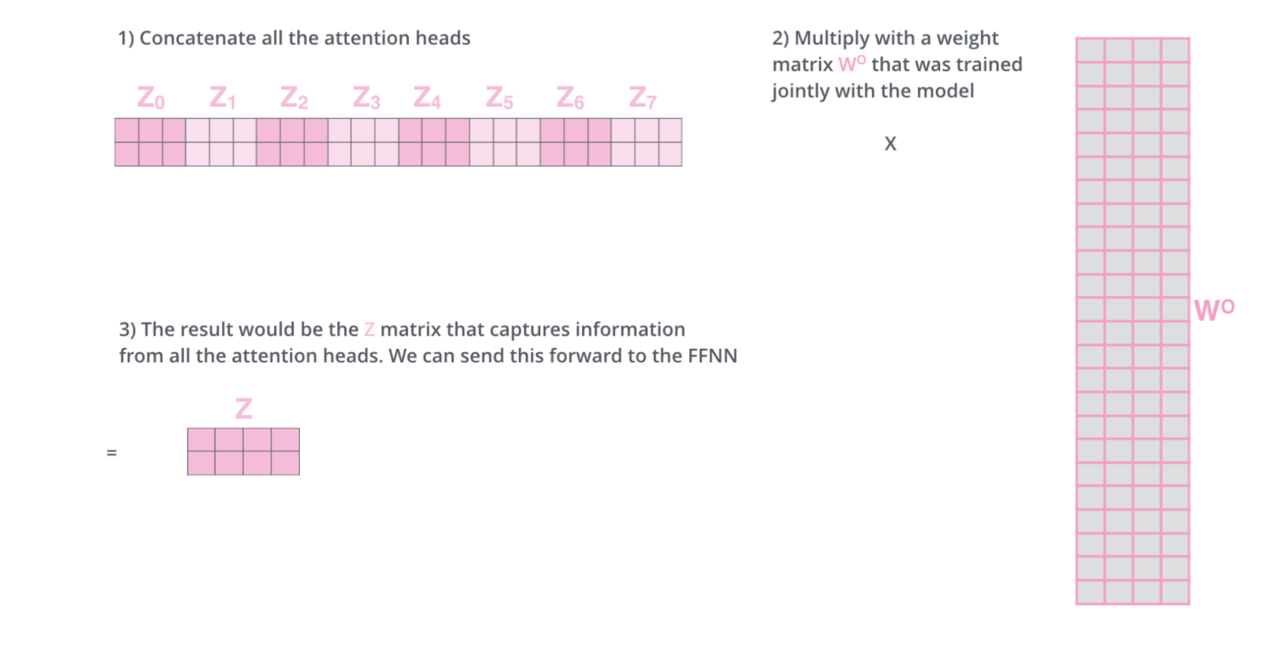
Combining contribution of all attention heads

Slide 23
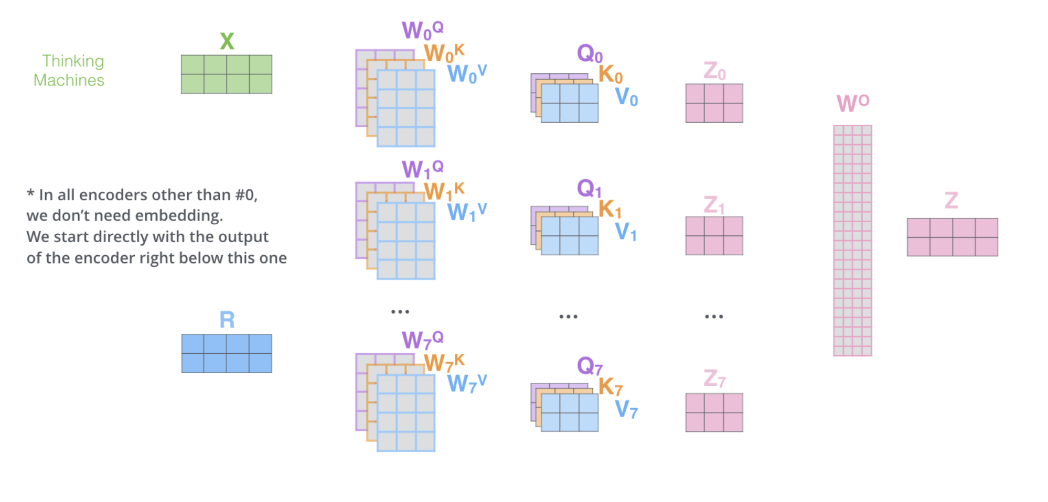
Multi-headed attention

Slide 24
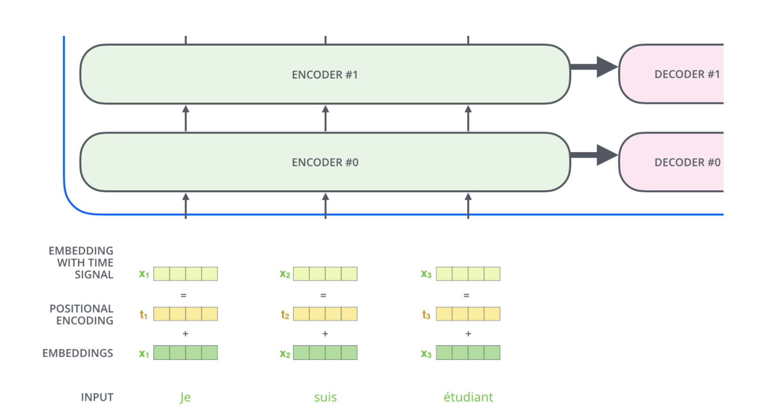
How do transformers learn order of words?
Position of Word is incorporated into embedding

Slide 25
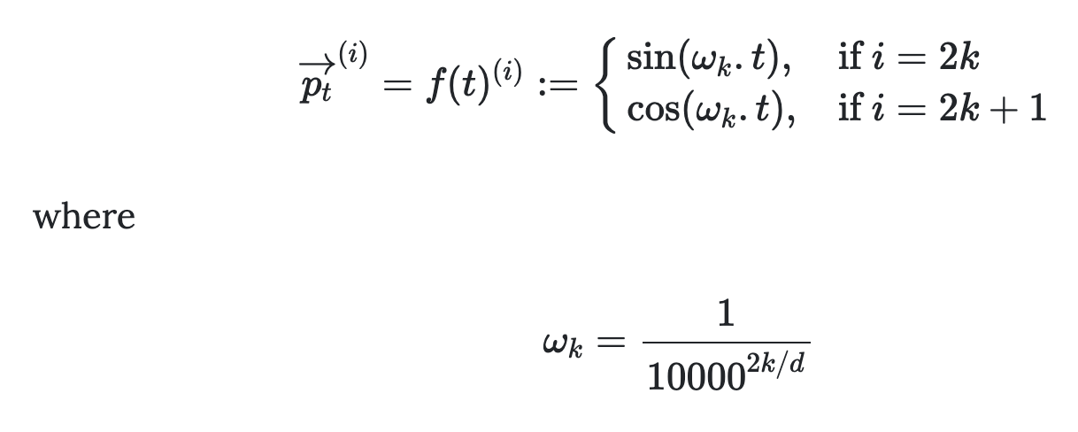
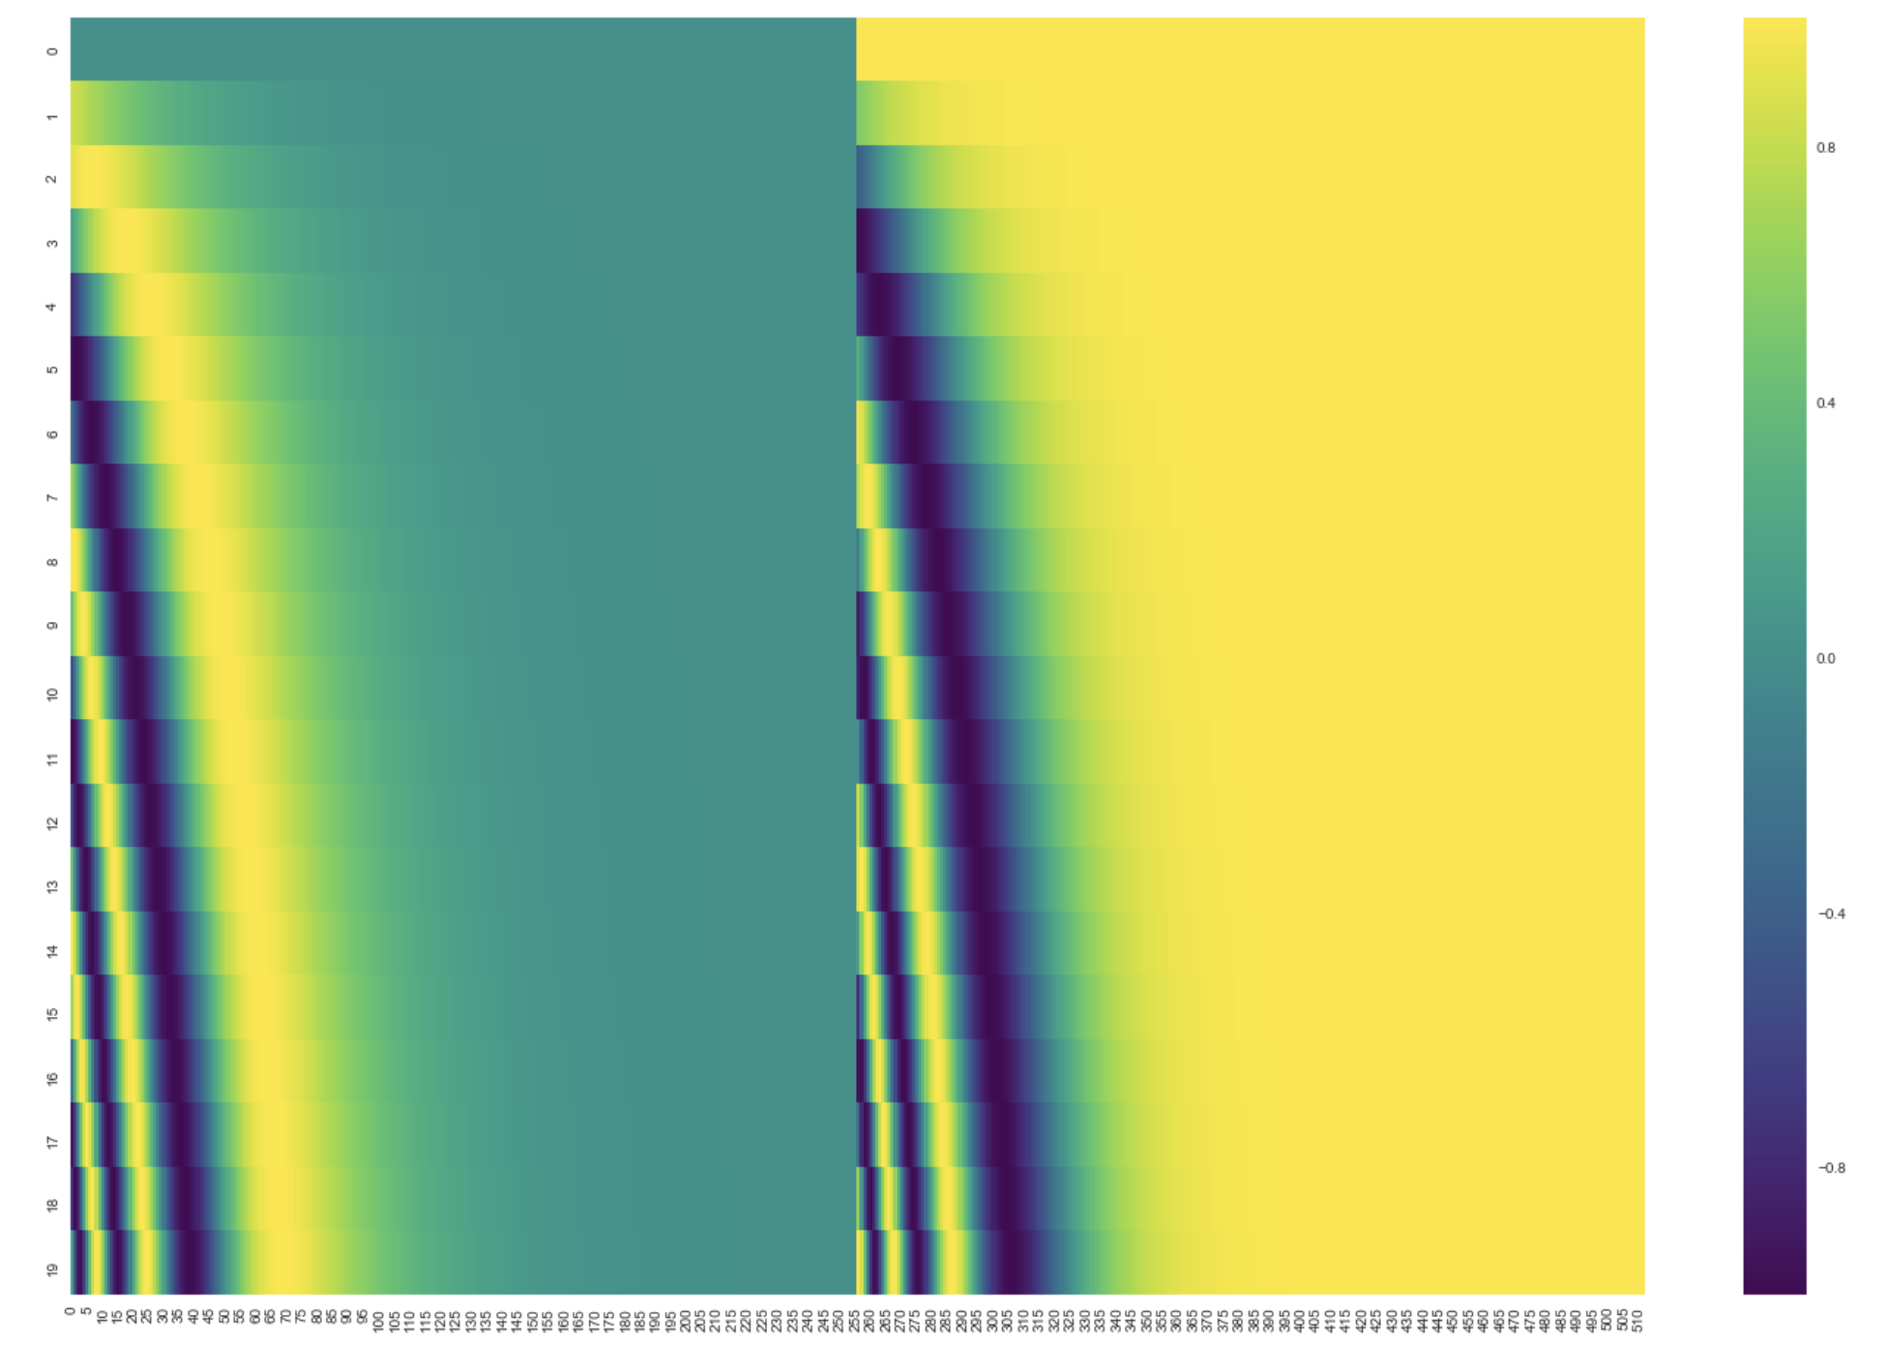
Positional Embedding
For (t) 512 dimensional Embedding
https://kazemnejad.com/blog/transformer_architecture_positional_encoding/

Slide 26
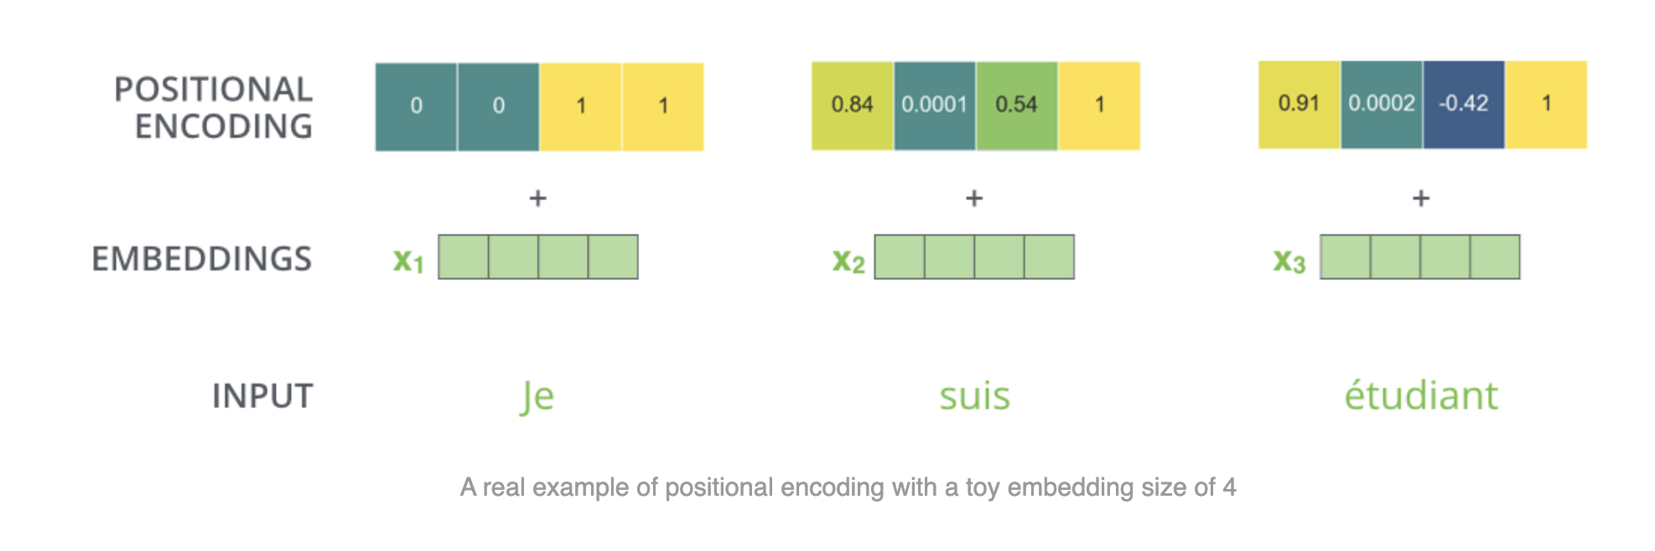
Example

Slide 27
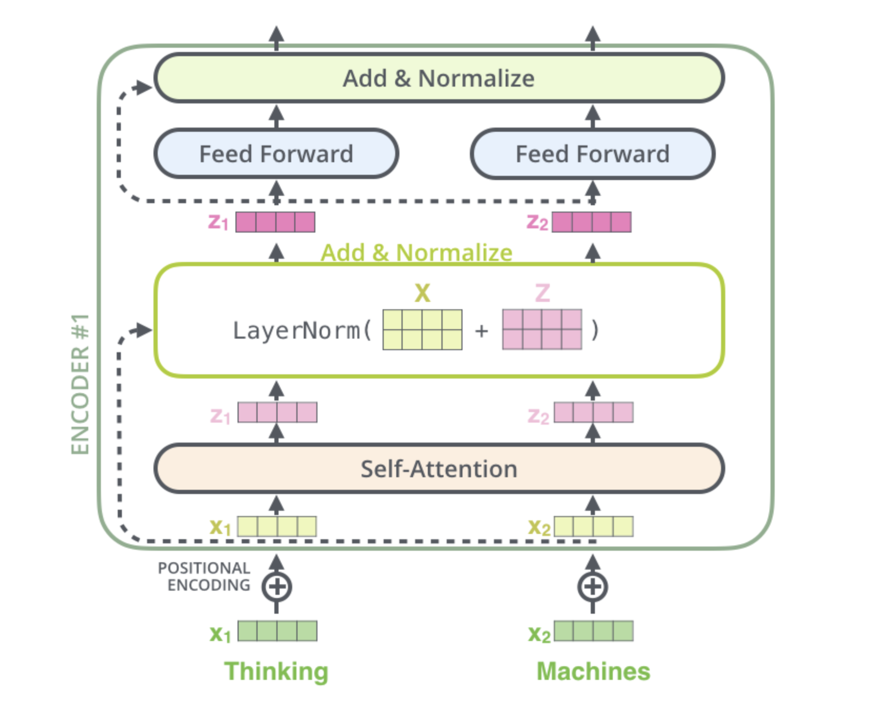
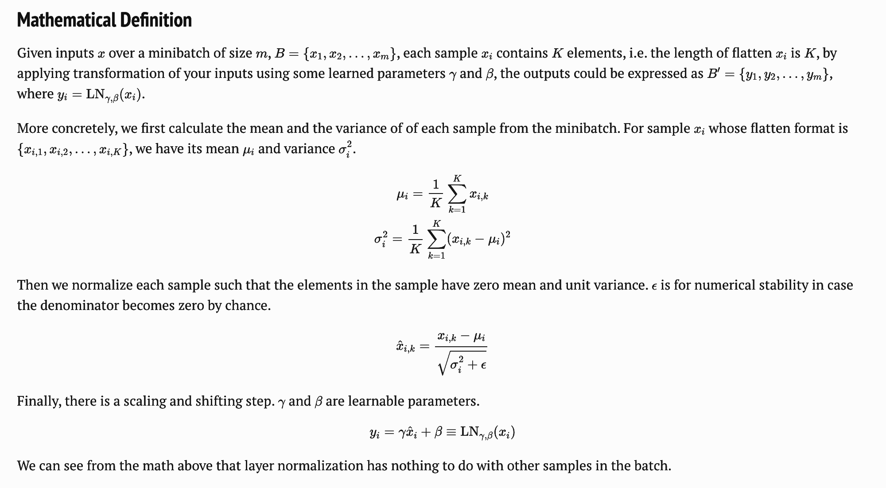
Normalization before moving on to next Encoder

Slide 28
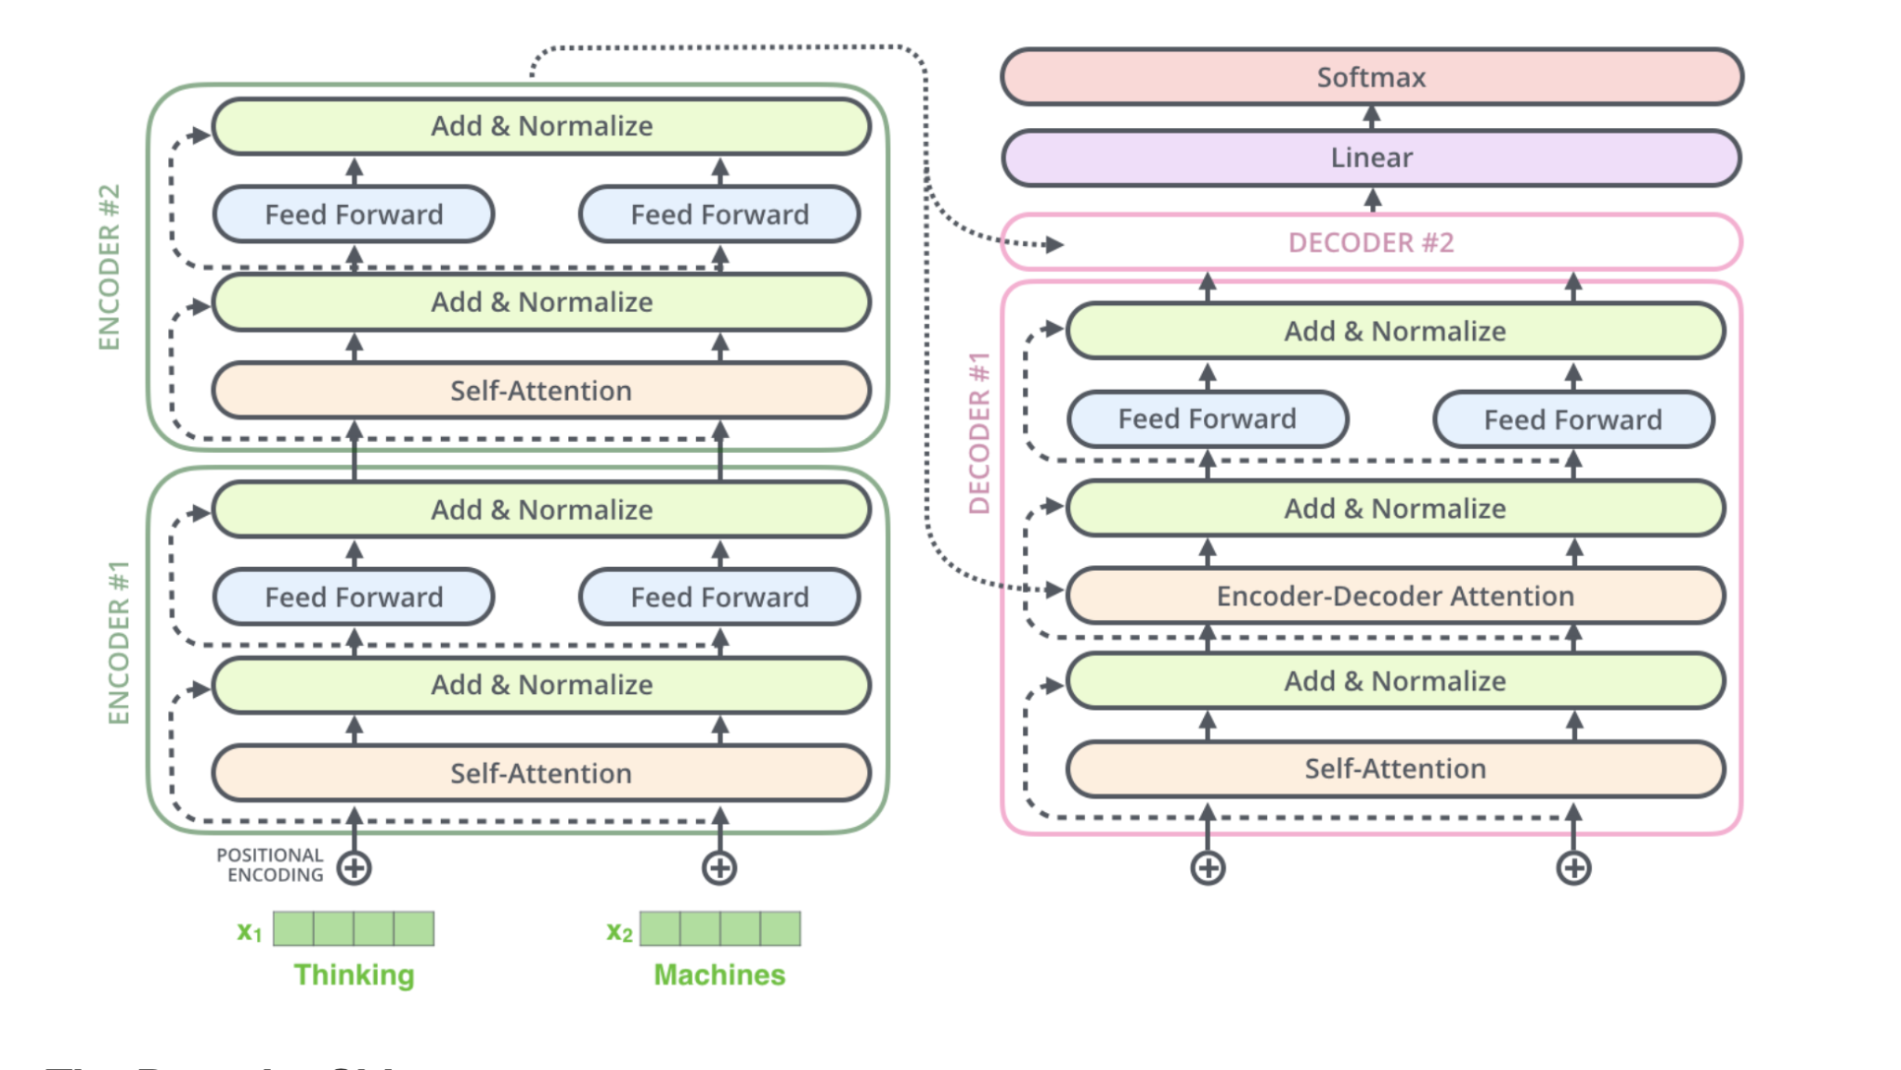
Encoder Decoder
Target Sentence in Language 2

Slide 29
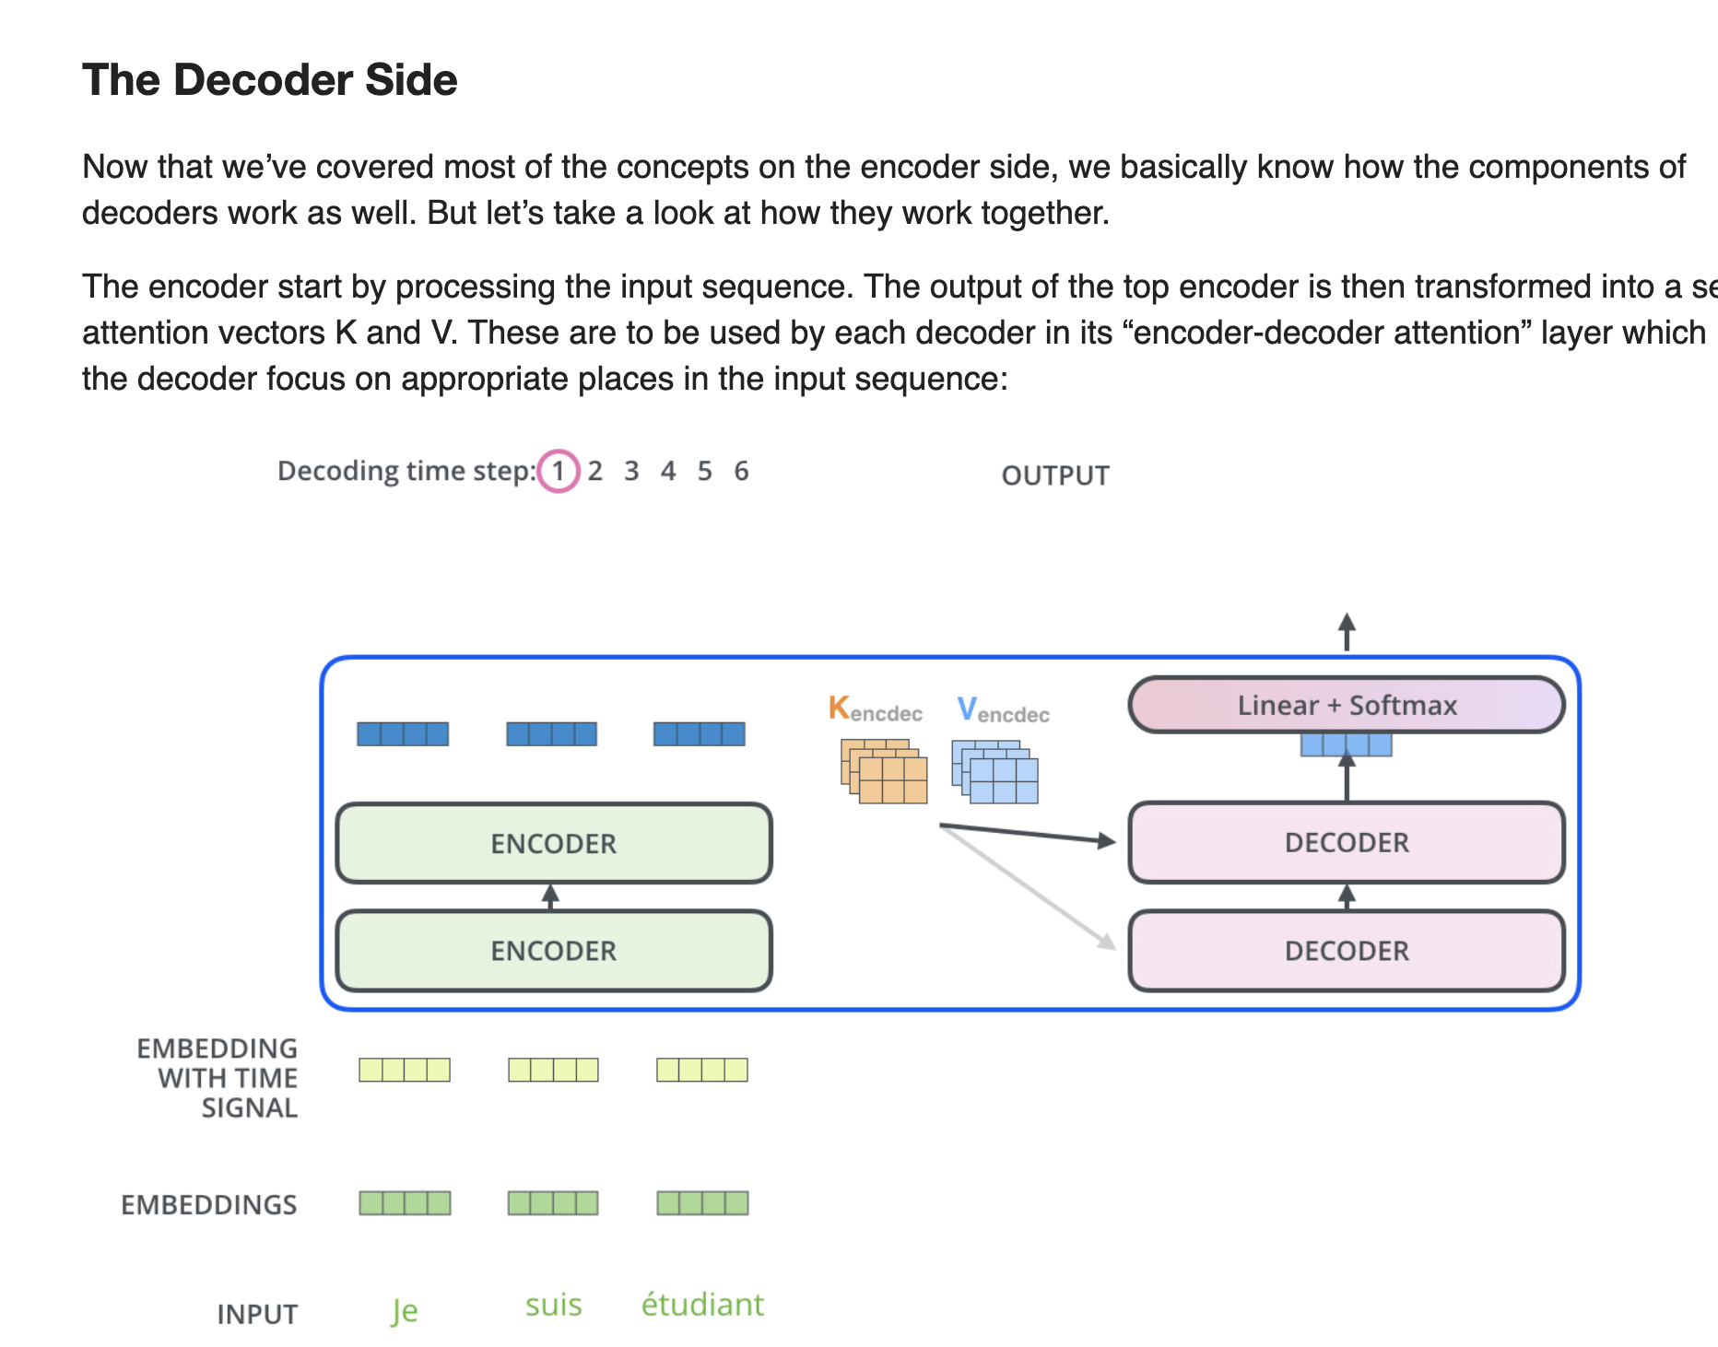
The Decoder
Output of the top encoder is transformed into a set of attention vectors K and V - these are used by each decoder in its “encoder-decoder attention” layer which helps the decoder focus on appropriate places in the input sequence:

Slide 30
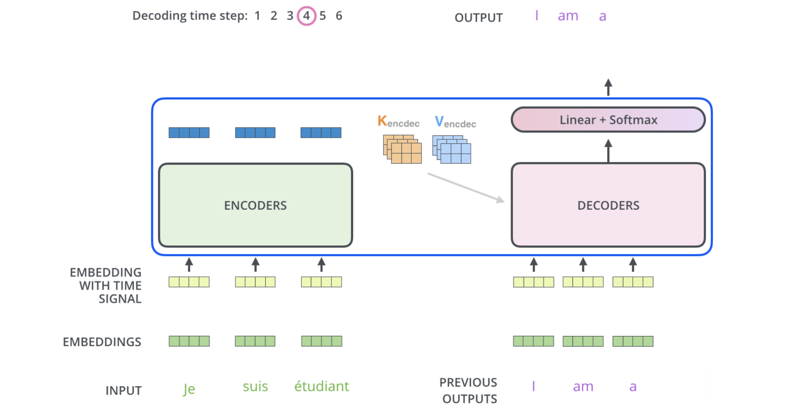
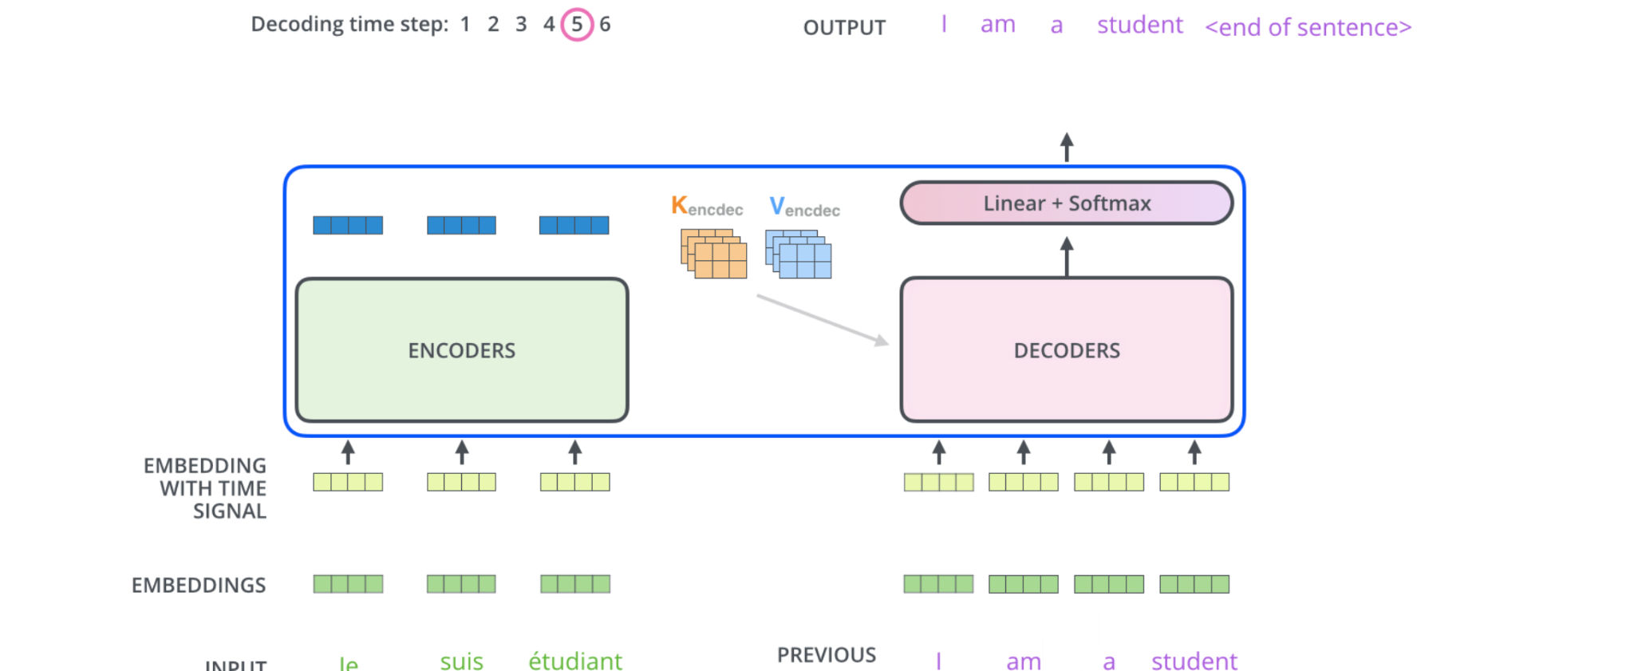
The self attention layers in the decoder are only allowed to attend to earlier positions in the output sequence
The “Encoder-Decoder Attention” layer works just like multiheaded self-attention, except it creates its Queries matrix from the layer below it, and takes the Keys and Values matrix from the output of the encoder stacks

Slide 31
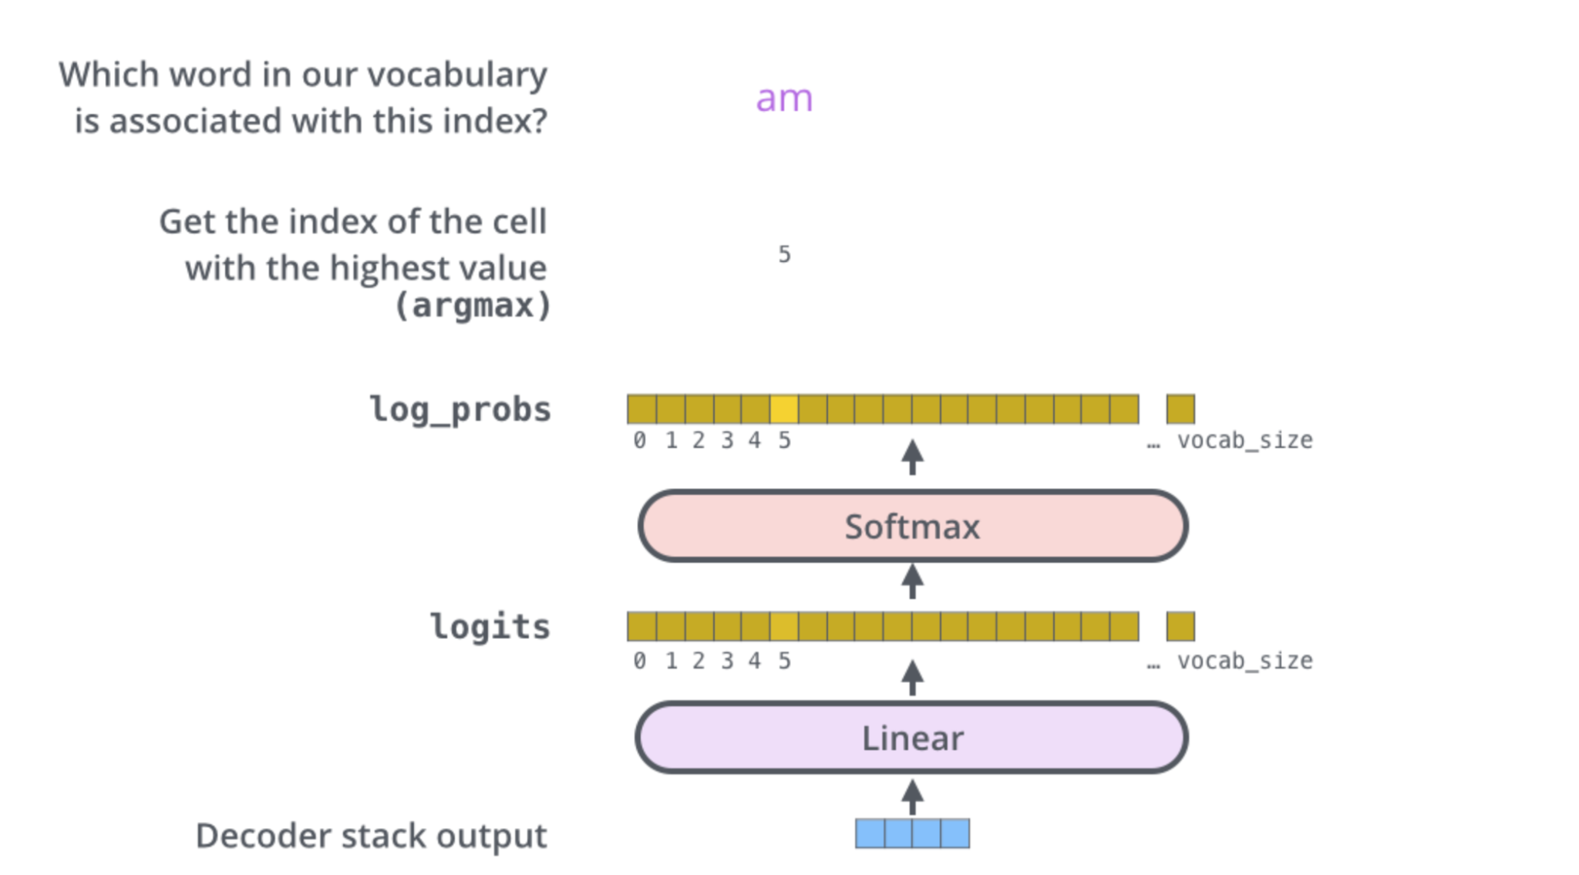
The final layer
Decoder stack outputs a vector of floats
Linear layer is a fully connected neural network that projects the vector into a much, much larger vector called a logits vector = size of vocabulary
The softmax layer then turns those scores into probabilities - The cell with the highest probability is chosen, and the word associated with it is produced as the output for this time step.

Slide 32
BERT - LANGUAGE MODELING
BERT, - is bidirectionally trained
It acquires a deeper sense of language context and flow compared to the single-direction language models
Bi-directional LSTMs look at a sentence from both directions – but not simultaneously
One looks at it from left – another looks at it from right
BERT looks at both context simultaneously

Slide 33
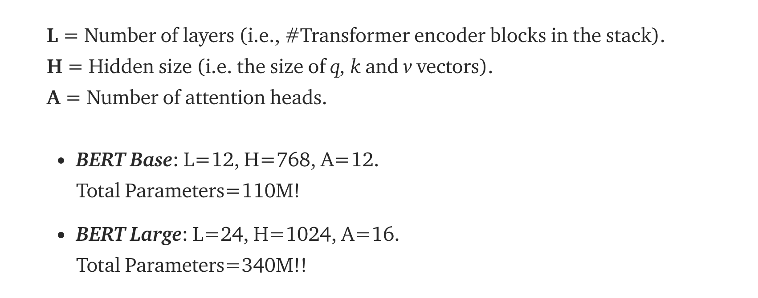
BERT parameters

Slide 34
BERT - Bi-directional Encoder Representations from Transformers
BERT applies bidirectional training of Transformer - which is an attention-based model, to learn language models
This is in contrast to previous efforts which looked at a text sequence either from left to right or combined left-to-right and right-to-left training
Being a language model which is bidirectionally trained - it has a deeper sense of language context and flow than single-direction language models
BeRT uses a novel technique named Masked LM (MLM) to learn

Slide 35
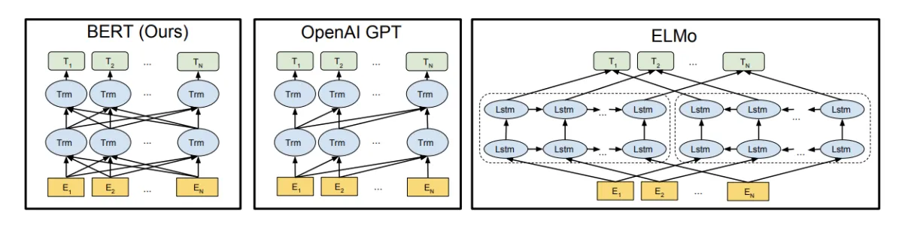
COMPARISON
(Google)

Slide 36
HOW DOES THE TRANSFORMER LEARN
Example task – to learn representation of the word bank in the sentence “I arrived at the bank after crossing the river”
During training - The Transformer will compare it to every other word in the sentence
The result of these comparisons is an attention score for every other word in the sentence
These attention scores determine how much each of the other words should contribute to the next representation of “bank”.
In the example, the disambiguating “river” would receive a high attention score when computing a new representation for “bank”
The attention scores are then used as weights for a weighted average of all words’ representations which is fed into a fully-connected network to generate a new representation for “bank”, reflecting that the sentence is talking about a river bank.

Slide 37
TRAINING – LEARNING WITH MASKING
Instead of predicting the next word in a sequence, BERT makes use of a novel technique called Masked Language Model (MLM):
It randomly masks words in the sentence and then it tries to predict them.
Given - “The woman went to the store and bought a _____ of shoes.” – BERT trains to predict what is in the blank
a language model might complete this sentence by saying that the word “cart” would fill the blank 20% of the time and the word “pair” 80% of the time.
BERT tries to “fill in the blank” based on context - bidirectionally trained

Slide 38
LANGUAGE MODELING USING BERT
Instead of predicting the next word in a sequence
BERT randomly masks words in the sentence and then tries to predict them.
Masking means that the model looks in both directions and it uses the full context of the sentence, both left and right surroundings, in order to predict the masked word.
The existing combined left-to-right and right-to-left LSTM based models were missing this “same-time part”.

Slide 39
Training in Masked Language Model
Mask some percentage of the input tokens at random, and then predict those masked tokens
Usually 15% of all tokens in each sequence at random
During training - all of the masked words are not replaced by the [MASK] token
If the i-th token is chosen –
it is replaced with the [MASK] token 80% of the time
a random token 10% of the time
the unchanged i-th token 10% of the time

Slide 40
PRE-TRAINING BERT – 2ND TASK
Task #2: Next Sentence Prediction (NSP)
To learn the relationship between two sentences, which is not directly captured by language modeling
Predict whether the second sentence follows the first
Training Inputs – pair of sentences
Trivially generated from any monolingual corpus.
Sentences A and B are chosen as follows
for 50% of the pre-training examples - B is the actual next sentence that follows A
For 50% samples – a random sentence from the corpus is picked up as B

Slide 41
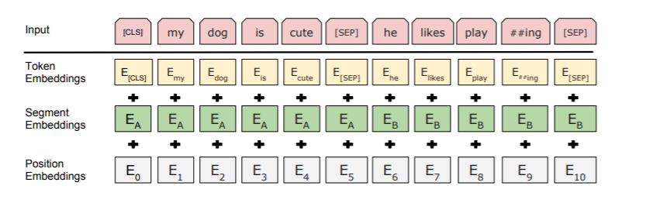
INPUT EMBEDDING – ADDING THE THREE
CLS - This token is used in classification tasks as a learnt representation of the entire sequence
It is ignored in non-classification tasks.

Slide 42
LEARNING FROM MASKED INPUTS BY BERT
Input – the man went to the [MASK1] $EOS$ he bought a [MASK2] of milk $EOS$
Labels: [MASK1] = store; [MASK2] = gallon
How often does store come in k_context of he, went, bought, milk
How often does she come in k_context of woman
Input – the man went to the [MASK1] $EOS$ he bought a [MASK2] of milk $EOS$
Labels: [MASK1] = shop; [MASK2] = packet
K is a variable quantity
It learns probabilities of all words at all values of k (less than max allowable size) at one go
Input – the woman went to the [MASK1] $EOS$ she bought a packet of [MASK2] $EOS$
Labels: [MASK1] = store; [MASK2] = cards

Slide 43
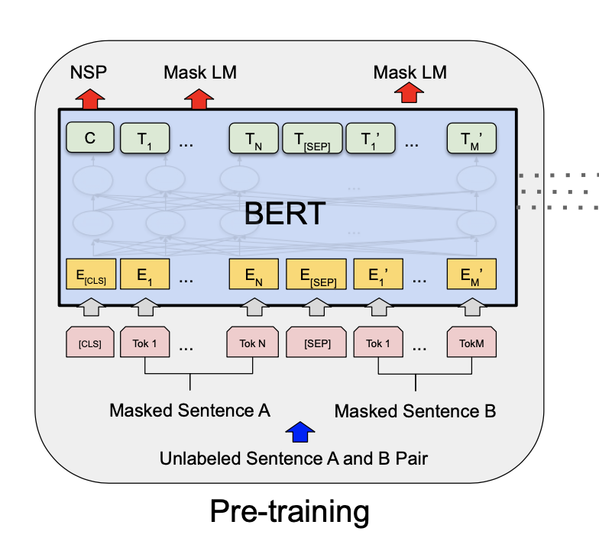
Power of BeRT
Many important downstream tasks such as Question Answering (QA) and Natural Language Inference (NLI) require understanding of relationship between two sentences
Not directly captured by language modeling
Joint training allows BeRT to be a good pre-trained model - which can be only fine-tuned for a wide variety of tasks

Slide 44
Pre-training beRT
The pre-training procedure largely follows the existing literature on language model pre-training
BooksCorpus (800M words)
English Wikipedia (2,500M words) - only text passages used - lists, tables, and headers ignored

Slide 45
Fine tuning
Fine-tuning for downstream tasks depends upon task - whether it involved single text or text pairs
For applications involving text pairs
Starting with pre-trained weights - BERT uses the same self-attention mechanism
Treats this as encoding a concatenated text pair

Slide 46
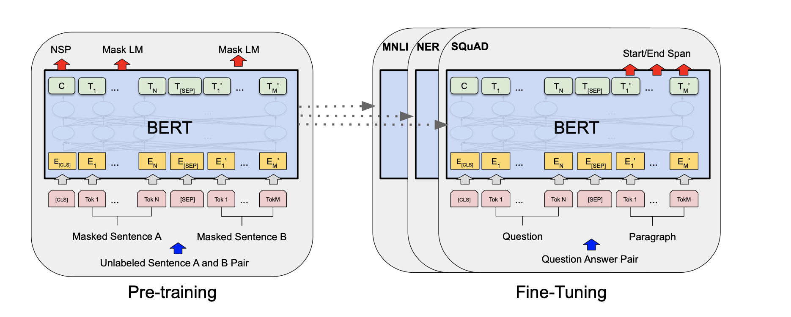

Slide 47
Fine tuning examples
Sentence A and sentence B from pre-training are analogous to
(1) sentence pairs in paraphrasing
(2) hypothesis-premise pairs in entailment
(3) question-passage pairs in question answering
(4) a degenerate text-∅ pair in text classification or sequence tagging

Slide 48
The output layer
At the output - the token representations are fed into an output layer for token- level tasks, such as sequence tagging or question answering
[CLS] representation is a special embedding that is fed into the output layer for classification, such as entailment or sentiment analysis
Additional Fully connected layers are introduced
Compared to pre-training, fine-tuning is relatively inexpensive

Slide 49
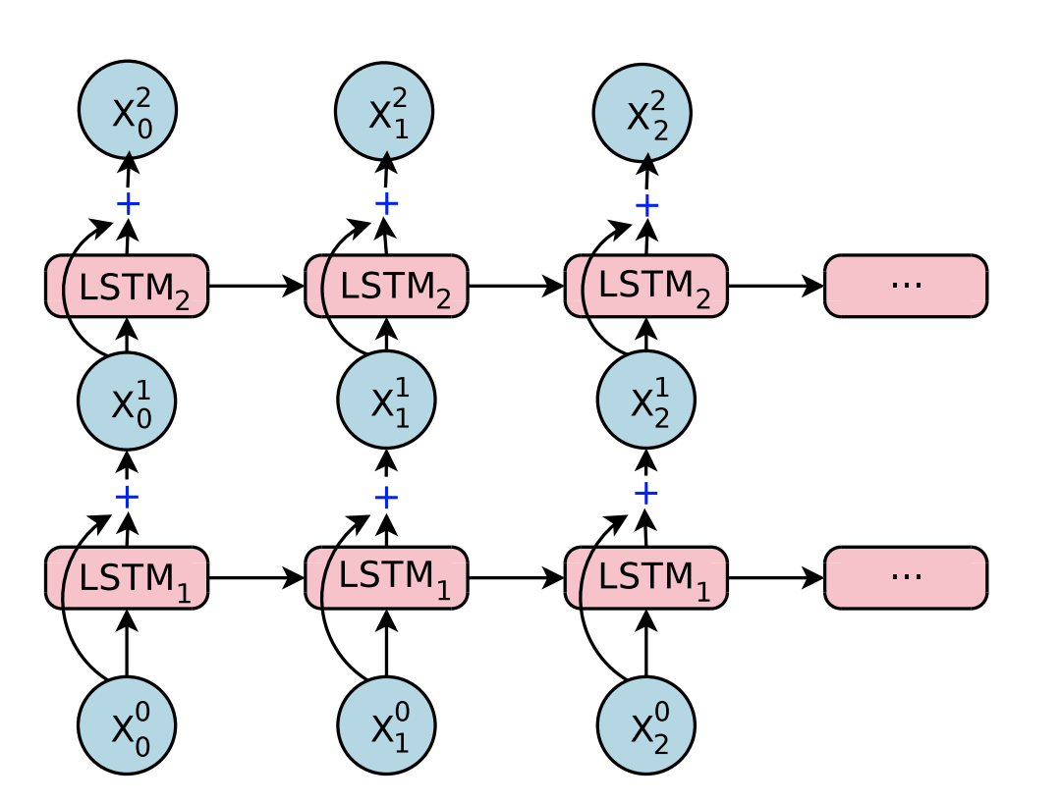
Wordpiece embeddings
30,000 tokens is found to be good to represent a very large vocabulary of English / European languages
Stacked LSTM with residual connections - 768 dimensional vector for the tokens

Slide 50
Sequence (Sentence / Document) Classification
What is the fine-tuning procedure for sequence classification tasks?
The final hidden state of the [CLS] token is taken as the fixed-dimensional pooled representation of the input sequence
This is fed to the classification layer
The classification layer is the only new parameter added and has a dimension of K x H, where K is the number of classifier labels and H is the size of the hidden state (output)
The label probabilities are computed with a standard softmax.

Slide 51
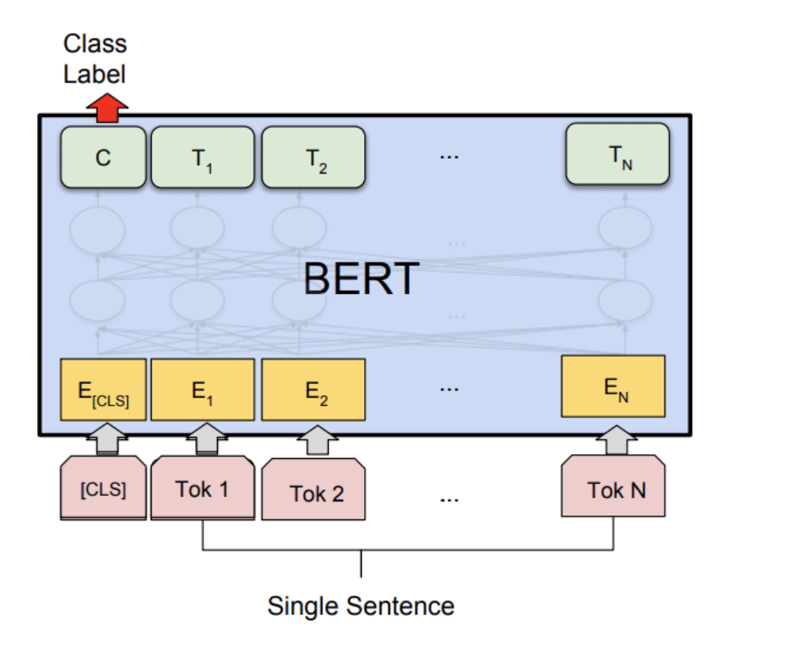
Sequence Tagging

Slide 52
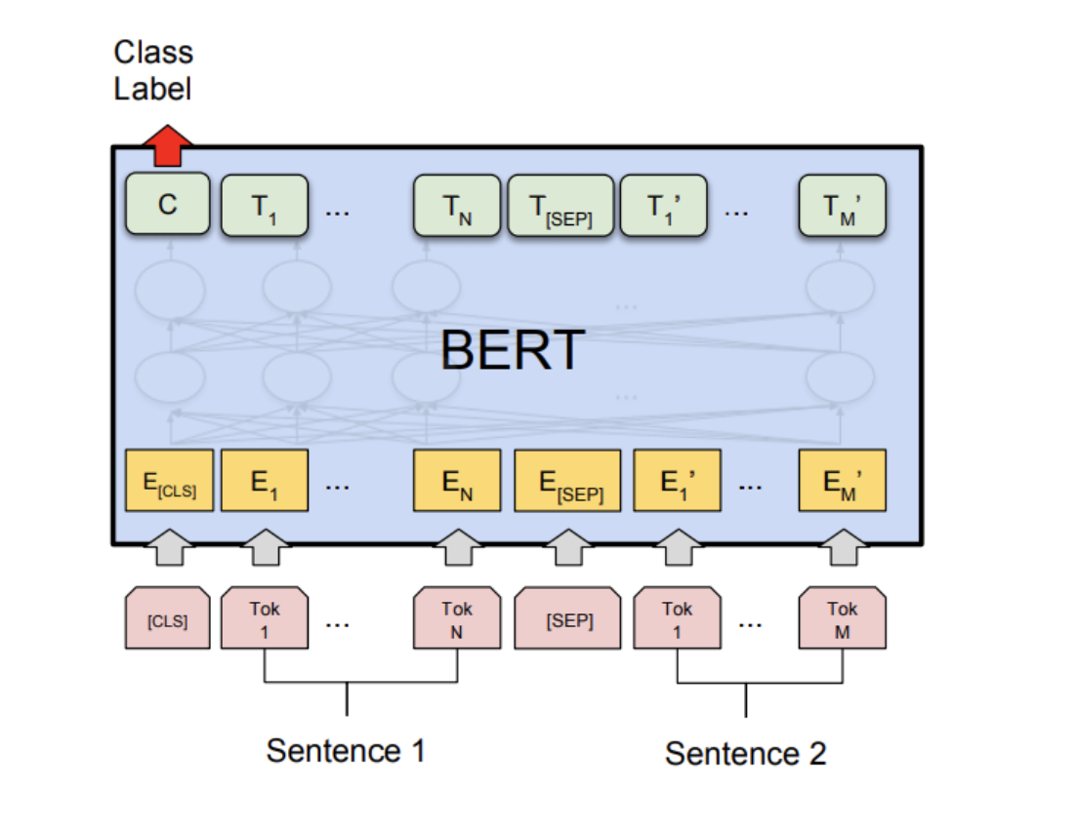
Sentence Pair Classifcation

Slide 53
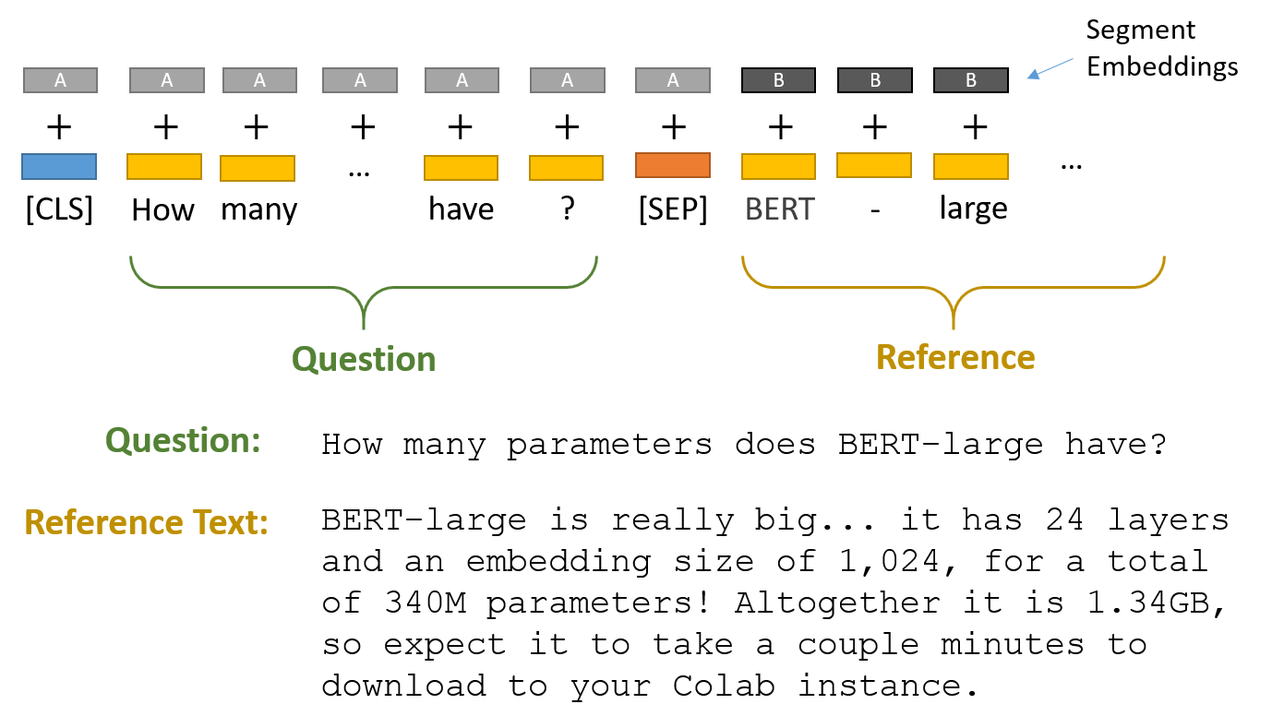
FINE TUNING BERT FOR QUESTION ANSWERING
Most “Question Answering” applications are developed for Stanford Question Answering Dataset (SQuAD)
SQuAD Task
Given a question, and a passage of text containing the answer – a QA system needs to highlight the “span” of text corresponding to the correct answer

Slide 54
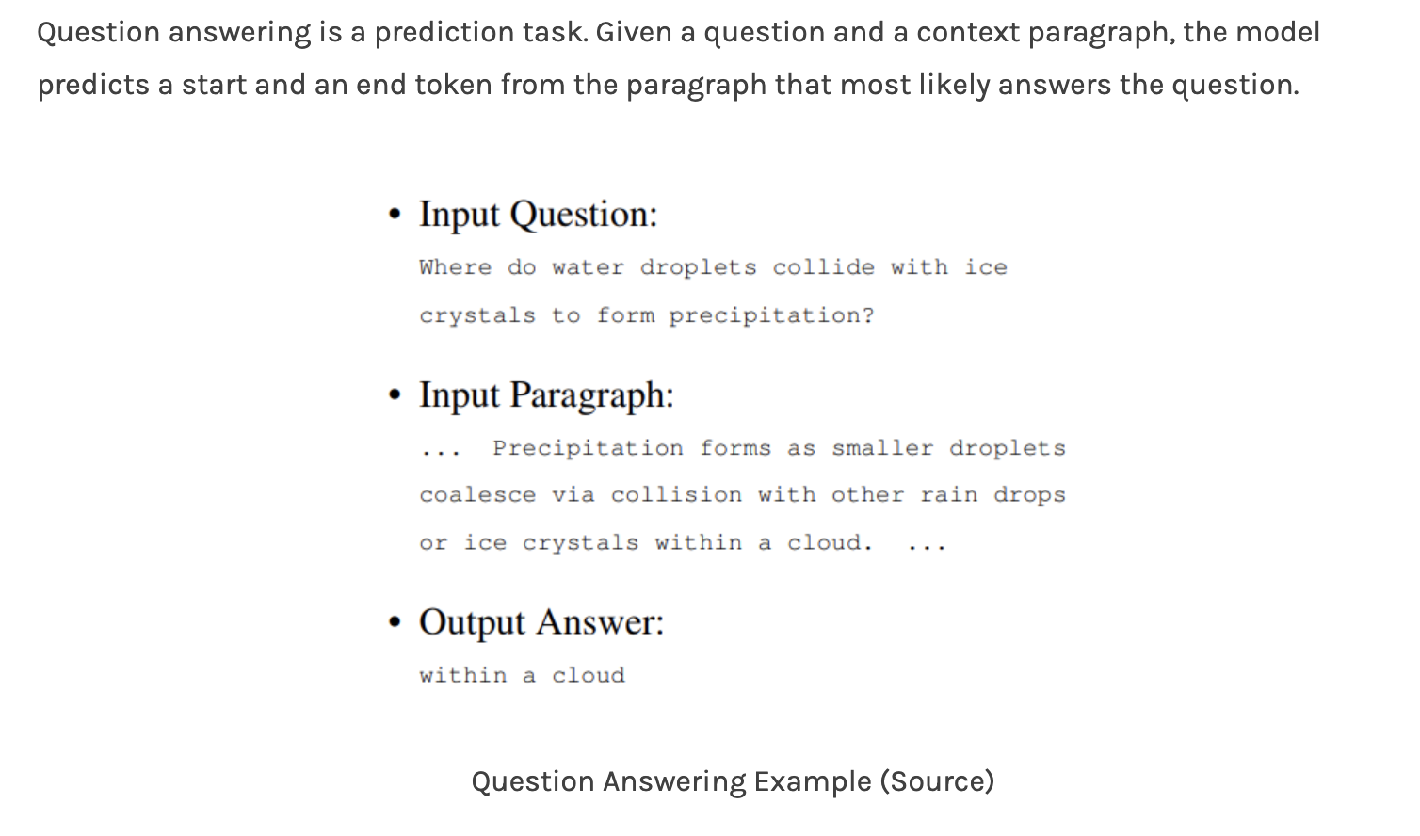

Slide 55
USING BERT TO DO THE TASK
Step 1 – Create Input pairs with Question and Reference Text as two segments

Slide 56
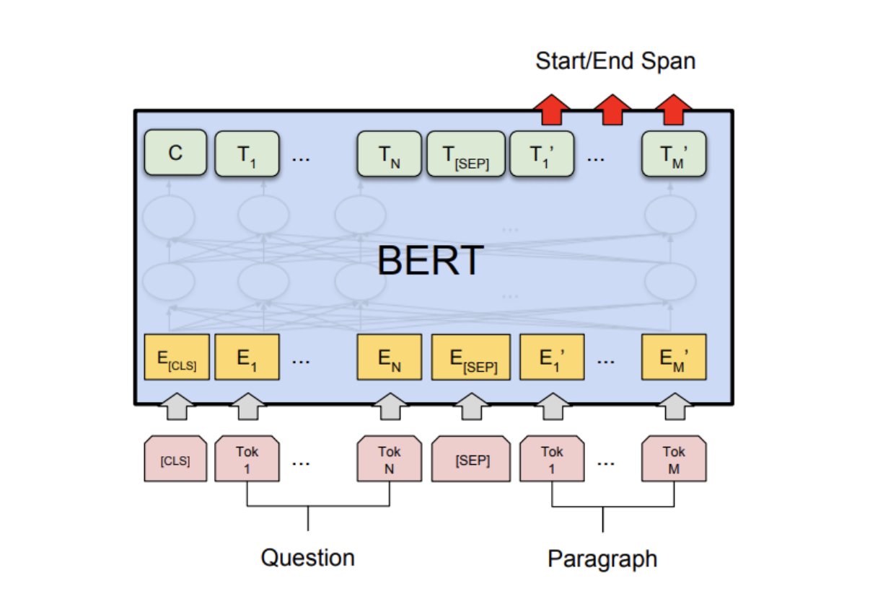
Learning start - end positions

Slide 57
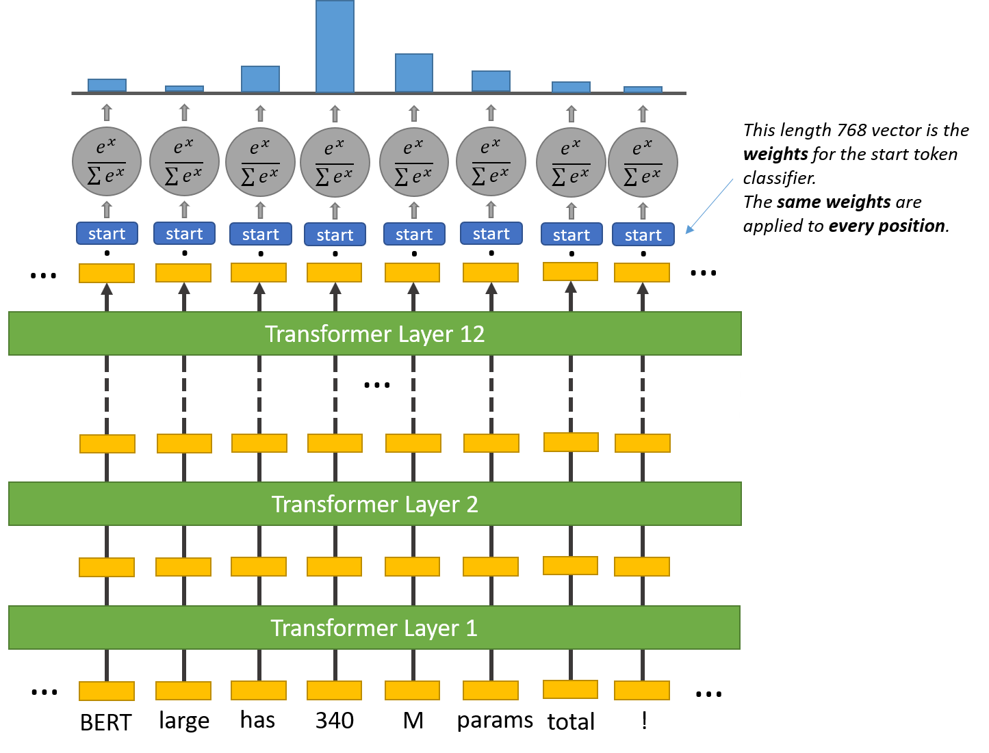
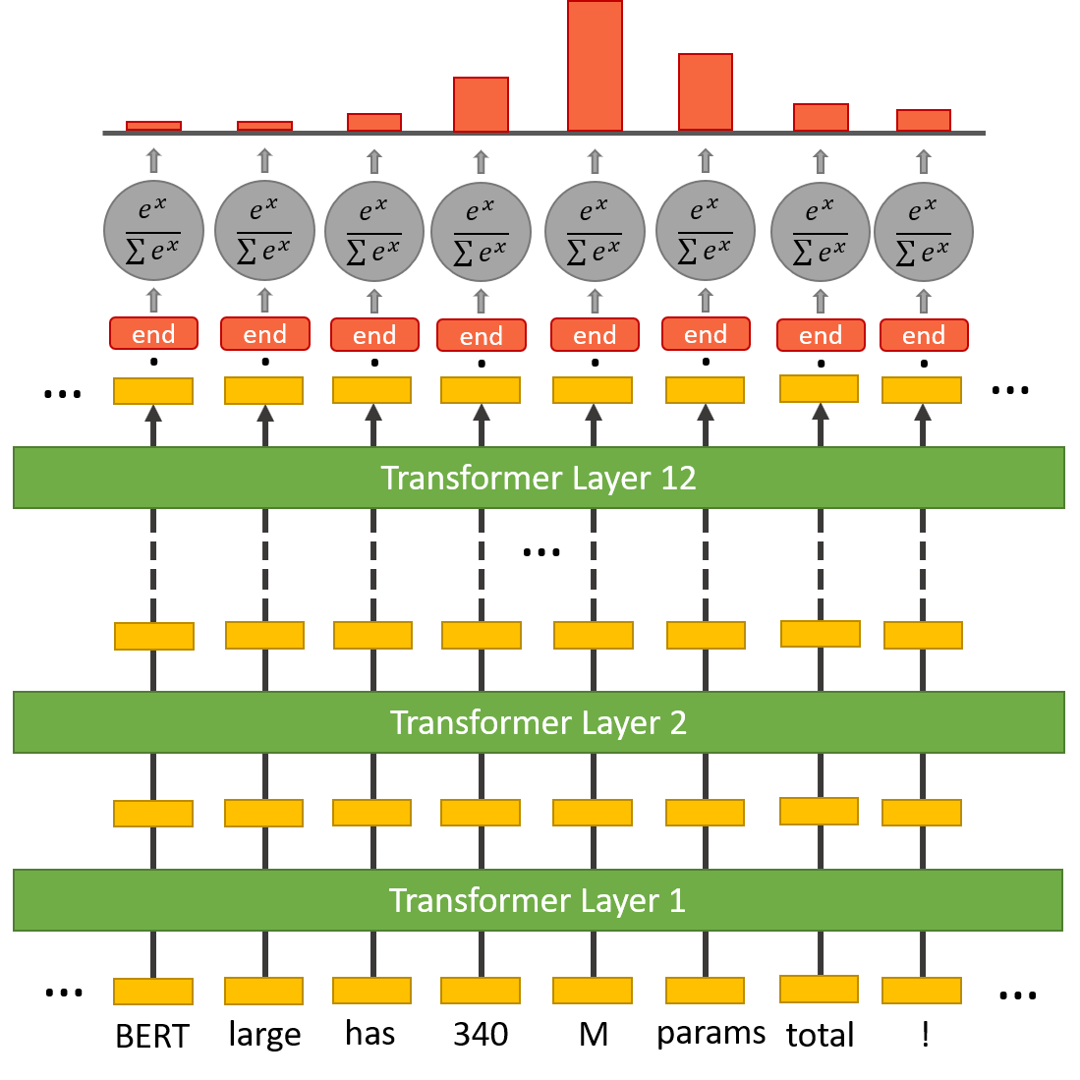
TRAINING BERT TO LEARN START & END TOKEN CLASSIFIERS ADDITIONALLY
Formulated as two prediction problems
For each token learn whether it is the START or END

Slide 58
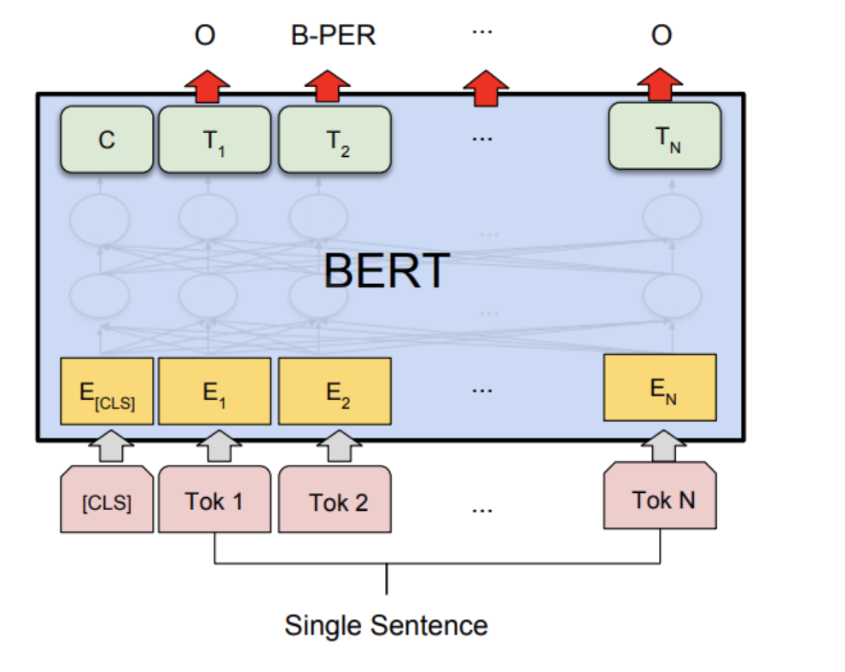
Sequence Labeling using BeRT
In tasks such as Named Entity Recognition - a tag must be predicted for every word in the input
The final hidden states (the transformer output) of every input token is fed to the classification layer to get a prediction for every token
Since WordPiece tokenizer breaks some words into sub-words, the prediction of only the first token of a word is considered.

Slide 59
Paraphrase Detection
Paraphrases refer to a set of sentences which mean same
May use same words in different order or different words
Sentence: Her life spanned years of incredible change for women as they gained more rights than ever before.
Paraphrase: She lived through the exciting era of women's liberation.

Slide 60
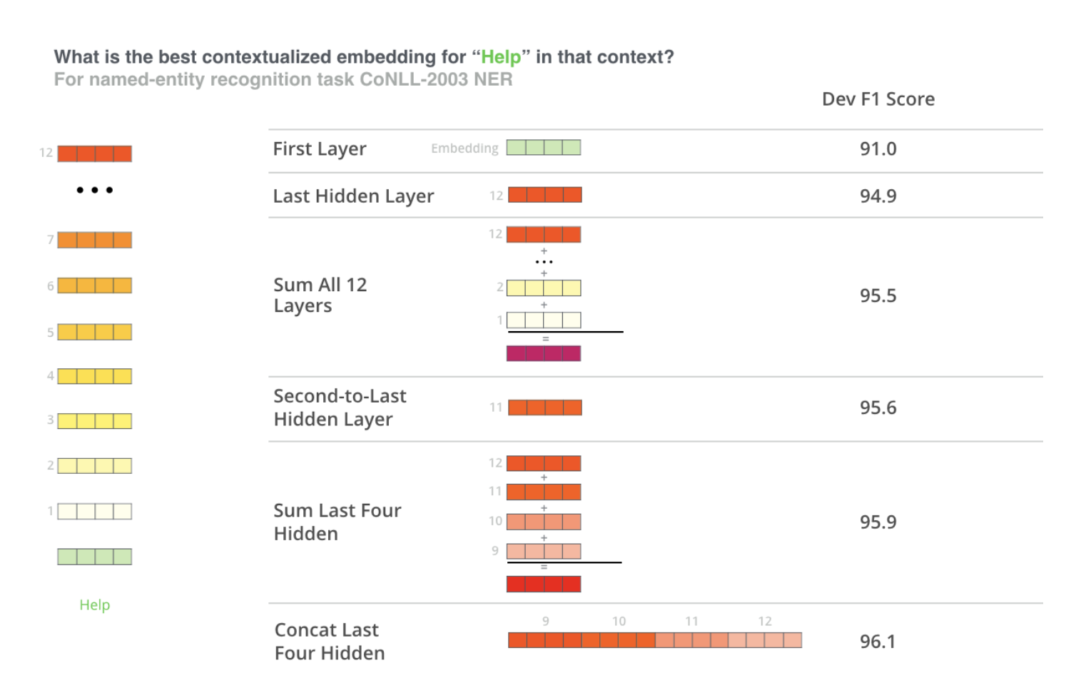
What is a word embedding generated by BERT?
Sum the last 4 layers of Encoder

Slide 61
Domain specific Language Models
SciBERT (biomedical and computer science literature corpus)
FinBERT (financial services corpus)
BioBERT (biomedical literature corpus)
ClinicalBERT (clinical notes corpus)
mBERT (corpora from multiple languages)
patentBERT (patent corpus)
LawBERT (Legal text)
M-BERT (Multi - lingual BERT)
trained on 104 mono-lingual corpus
Can learn a task in one language - and perform it in another language

Slide 62
Questions
Can BeRT handle Out of Vocabulary words?
Between BeRT and ElMO - who is likely to have limitation on input sentence length?
BeRT can be used with tensorflow, PyTorch, Keras

Slide 63
What Language Models Can’t Do
Common Sense Reasoning
Using Knowledge from multiple sources
Explicit and Implicit
Role disambiguation

Slide 64
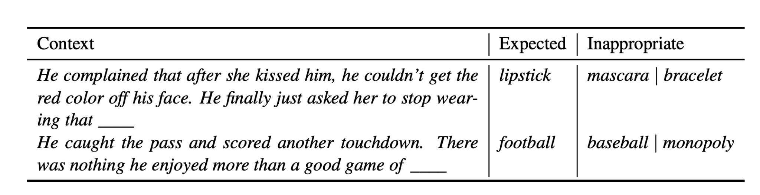
Sensitivity Test

Slide 65

2. Event knowledge and semantic role sensitivity
X

Slide 66

Handle Negation Tasks

Slide 67
CONTEXTUAL EMBEDDING OF WORDS
Models to create Context-based word representations are needed to generate different representation for the same word in different contexts
Context-free models like word2vec generate a single word embedding representation (a vector of numbers) for each word in the vocabulary
BERT will generate different representations depending on the sentence using a transformer architecture

Slide 68
SELF ATTENTION
Self-attention also called intra-attention
An attention mechanism relating different positions of a single sequence in order to compute a representation of the sequence.
Self-attention has been used successfully in a variety of tasks including reading comprehension, abstractive summarization, textual entailment and learning task-independent sentence representations

Slide 69
ENCODER – DECODER STRUCTURE
Encoder maps an input sequence of symbols (x₁, ..., x_{n}) to a sequence of continuous representations z = (z₁, ..., z_{n}) – sequence to sequence model
Given z, the decoder then generates an output sequence (y₁, ..., y_{m}) of symbols one element at a time
At each step the model is auto-regressive - consuming the previously generated symbols as additional input when generating the next
This recurrent neural network architecture was the core technology inside Google’s service
Also called “Sutskever model” for direct end-to-end machine translation.

Slide 70

The Transformer follows stacked self-attention and point-wise, fully connected layers for both the encoder and decoder
In each step, it applies a self-attention mechanism which directly models relationships between all words in a sentence, regardless of their respective position
Example - “I arrived at the bank after crossing the river”
To compute the next representation for a given word - “bank” for example - the Transformer compares it to every other word in the sentence and derives an attention score for every other word in the sentence
These attention scores determine how much each of the other words should contribute to the next representation of “bank”

Slide 71
Encoder is composed of a stack of N = 6 identical layers
Each layer has two sub-layers
A multi-head self-attention mechanism
Positionwise fully connected feed-forward network.
Output of each sub-layer is LayerNorm(x + Sublayer(x)), where Sublayer(x) is the function implemented by the sub-layer itself
All sub-layers in the model, as well as the embedding layers, produce outputs of dimension dmodel = 512.
Decoder is also composed of a stack of N = 6 identical layers
Three sub-layers in each layer
One additional multi-head attention over the output of the encoder stack
Residual connections around each of the sub-layers, followed by layer normalization
Output embeddings are offset by one position, ensuring that the predictions for position i can depend only on the known outputs at positions less than i.

Slide 72

ATTENTION
An attention function is a function that maps a query and a set of key-value pairs to an output
Query, keys, values, and output are all vectors
The output is computed as a weighted sum of the values,
where the weight assigned to each value is computed by a compatibility function of the query with the corresponding key

Slide 73

LEARNING CONTEXTUAL ASSOCIATION SCORES THROUGH ATTENTION
The input consists of queries and keys of dimension d_{k} and values of dimension d_{v}
Compute the dot products of the query with all keys
Divide each by √ d_{k} and apply a softmax function to obtain the weights on the values
In practice, the attention function is computed on a set of queries simultaneously, packed together into a matrix Q
The keys and values are also packed together into matrices K and V
Matrix of outputs is computed as:
Query Bank – Position key (i) – value - river
Query Bank – Position key (1) - value - money

Slide 74
ADVANTAGE OVER RNN AND CNN
Learning long-range dependencies is a key challenge for sequential networks
Ability to learn such dependencies is affected by the length of the paths forward and backward signals have to traverse in the network
Shorter paths are learnt better in RNN or CNN
Self-attention layer of BERT connects all positions with a constant number of sequentially executed operations
Self-attention layers are therefore faster than recurrent layers

Slide 75
USING PRE-TRAINED BERT FOR NLP TASKS
Two main strategies:
The feature-based approach, which uses the pre-trained representations as additional features to the downstream task
Task-specific architecture are created and parameters tuned for it
Fine-tuning BERT
fine-tunes deep bi-directional representations for the task with minimal task-specific parameters

Slide 76
TRADITIONAL NLP TASKS
Sentence Classification
Named Entity Recognition
Question Answering
Paraphrasing
Easy
Original - He loves to eat pizza.
Paraphrase - Pizza is his favorite dish.
Difficult
Original: Her life spanned years of incredible change for women as they gained more rights than ever before. Paraphrase: She lived through the exciting era of women's liberation.

Slide 77

FEATURE BASED APPROACH FOR SENTENCE – PAIR CLASSIFICATION
Load pre-trained Model
Attach an additional layer for classification
A Dense layer for classification with Softmax at output
There exists a BertClassifier Model which loads pre-trained sentence representations
Reads additional inputs for training
And runs the classifier
With very few epochs
Learns classification

Slide 78
CLASSIFICATION
For every token in the text – its final embedding is fed to the START / END token classifiers
Each classifier has a single set of weights which is learnt during training
After taking the dot product between the output embeddings and the START / END weights - apply the softmax activation to produce a probability distribution over all of the words
During training – the actual START / END token should have the maximum weight
During application - Whichever word has the highest probability of being the START/END token is the one that is picked as answer

